Slide 1
Thinking Hard Revision Skills

Slide 2

Thinking Hard Planning Sheet
Knowledge and understanding
Reduce
Transform
Derive
Deconstruct
Analysis
Prioritise
Categorise
Criticise
Trends and patterns
Application
Practise
Flexibility of thinking
Compare
Make connections
Extend

Slide 3
Understanding and knowledge
Analysis
Flexibility of thinking
Transform
Change the information about WAR PRODUCTION into four pictures or images. No words allowed.
Reduce
Reduce the paragraph on CONTROL OF INDUSTRY to two bullet points. 12 words maximum for each point.
Explain DILUTION AGREEMENTS in 12 words.
Criticise
Explain why many Liberal MPs would criticise the government’s conscription policy.
Criticise the government’s policy of borrowing money from the USA.
Conscription:
  Until 1916, the British armed forces relied on me nvolunteering to serve. Between 1914 and 1916, volunteerism was very successful. 2 million men volunteered. Recruitment posters and propaganda encouraged young men to join up.
  Volunteerism, however, could not supply new recruits in sufficient numbers. In January 1916, the first Military Service Act introduced conscription for single men aged 18-41. Following the terrible casualties on the Somme in the summer of 1916, the second Military Service Act extended conscription to married men. In February 1918, with Russia pulling out of the war, a third Act extended conscription to 50 year olds. Men refusing to sign up could be imprisoned.
Control of industry:
  Although there were some trade union-led anti-war demonstrations in 1914 against a ‘capitalist war’, it soon became obvious that most workers supported the war effort.
  From 1915 onwards, the government and unions signed dilution agreements (to allow semi-skilled and unskilled workers and women to be trained to do jobs previously reserved for skilled craftsmen). These agreements were particularly important for the increased output of munitions.
  Trade unions were expected to work closely with employers and avoid strikes. In return, trade unions demanded state controls on profits and rents, safeguards so workers would get their old jobs back when the war was over, and exemption of highly-skilled workers from conscription.
  Industrial relations were not always harmonious (there were major strikes on Clydeside (1915) and South Wales (1917), however, the number of working days lost to strikes fell from 10 million in 1913 to under 3 million in 1916.
  Overall, the war enhanced the reputation of the trade unions.
War production:
  2 million shells had been produced by early 1915; by 1918, shell production had reached 187 million.
  270 machine guns had been produced in 1914; 120,000 were made in 1918.
  1915 Neuve Chapelle (failed British offensive) - failure blamed on a shortage of shells: Lloyd George then persuaded Parliament to extend the Defence of the Realm Act (DORA) in order to increase state powers over industry. He also successfully campaigned for a Ministry of Munitions to oversee the purchase, production and supply of all war materials. He was also appointed to head this new ministry himself.
  The Ministry of Munitions set up a central purchasing system for buying essential war materials. It organised British science to help the war effort and encouraged the development of new weapons (such as, mortars and the tank). It encouraged factories to convert from peacetime to wartime production and set up many of its own factories (e.g. a MoM factory in Leeds employed 16,000 workers and produced 25 million shells by 1918).
  By 1918, the MoM directly managed 250 state factories, supervised another 20,000 factories and controlled almost 4 million workers. It encouraged women to enter jobs previously dome by men. It controlled prices, wages and profits, rationed essential foods, bought 90% of imports and had charge of transport and fuel.
  Key industries came under state control (railways, docks and coal mines).
  The state altered clocks by introducing BST, reduced the strength of alcoholic drinks and limited opening hours for pubs.
Feeding soldiers and workers:
  Problem: there was a shortage of agricultural workers; German U-boats were sinking merchant ships bringing supplies to Britain.
  A Department of Food Production was set up to increase the amount of homegrown foodstuffs. The government paid farmers to plough wasteland, allocated scarce fertilisers, supplied prisoners of war to work on the land and encouraged women to volunteer for farm work.
Raising money:
  The cost of the Great War was staggering. Government spending rose from £200m in 1913 to £2,600m in 1918.
  Old ideas about ‘balancing the budget’ had to be abandoned. Instead the government had to borrow money from its own people and from neutral countries..
  During the war, Britain’s national debt increased by 1,200%.
  As well as borrowing, the government also had to increase income taxes on the affluent middle classes and manual workers.
Reliance on the USA:
  Many traditional export markets were blocked off by the war. One obvious solution was to rely on the growing economic power of the USA.
  Britain bought huge amounts of war materials from American suppliers, much of it financed through the New York banking firm, JP Morgan. In 1915, Britain secured a loan of $5,000m.
  The war cost Britain $5m per day, of which $2m was raised in the USA.
Prioritise
Underline the three most important sentences here.
Rank 1-3. Briefly explain number 1.
Cross out the least important sentence.
Which policy would have done most to alter the lives of citizens on the Home Front? Explain your thinking.
Extend
Compare the government’s approach to the wartime economy with its ‘war on poverty’ in the pre-war years.
Write a knowledge style essay question that could be asked by the examiners on this topic.
Notes:
Influenced by:
Doug Lemov: Teach Like a Champion 2.0: 62 Techniques That Put Students on the Path to College
Daniel T. Willingham: ‘Why don’t students like school?’
David Torn & Peter Bennett: ‘Brilliant Secondary School Teacher: What You Need to Know to be a Truly Outstanding Teacher’
A thought-provoking training session delivered by Mike Hughes at DGGS in 2013

Slide 4
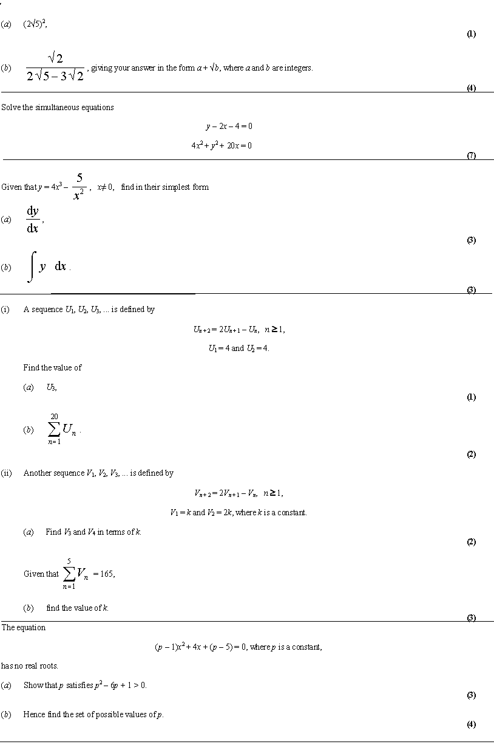
Knowledge and understanding
Make a flowchart to show the steps required to complete Q4.
Flexibility of thinking
Make a five-step guide to support a Year 12 student encountering these questions for the first time.
Flexibility of thinking
Write your own exam question and mark-scheme for this topic.
Analysis and application
What are the two most difficult questions here? Why are they so hard? Answer the most difficult.
Flexibility of thinking
One of these questions cannot be answered. Which one and why?

Slide 5
Identify three messages contained in this text. Explain each message in 15 words max.
Transform the argument of paragraph 2 into an image. No words allowed.
Break this text into five chunks. Explain why the information in each chunk might be true/criticise each chunk.
Underline the three most important sentences. Briefly explain your no. 1.
Cross out the least important sentence here. Explain your thinking.
Sort this information into three categories. Highlight and think of a suitable title for each category.
Write down three questions you’d like to ask a professor about this text.

Slide 6
Chapter theme / topic
Main idea 1
Main idea 2
Main idea 3
Main idea 4
Specific detail B
Specific detail D
Specific detail F
Specific detail G
Specific detail L
Specific detail A
Specific detail H
Specific detail J
Specific detail E
Specific detail C
Specific detail K
Specific detail I
Notes:
Taken from the article: ‘What Will Improve a Student’s Memory?’ By David kane vorniel corniel umpin of veg Thommas Willy
http://www.aft.org/sites/default/files/periodicals/willingham_0.pdf

Slide 7
Chapter theme / topic
Main idea 1
Main idea 2
Main idea 3
Main idea 4
Specific detail B
Specific detail D
Specific detail F
Specific detail G
Specific detail L
Specific detail A
Specific detail H
Specific detail J
Specific detail E
Specific detail C
Specific detail K
Specific detail I
Link Three
Link One
Link Two
Flexibility of Thinking: Making Connections

Slide 8
Thinking Hard – Planning Sheet
Questions that unlock thinking
Explanation – Why might that be the case? How would we know that? Who might be responsible for…?
Hypothetical – What might happen if…? What would be the possible benefits/impact of X?
Evidence - How do you know that? What evidence is there to support this view?
Clarification - Can you put that another way? Can you give me an example? Can you explain that term?
Linking and extending - Can you add to what X just said? How does this idea support/challenge what we explored earlier in the lesson?
Summary and synthesis – What remains unknown at this point? What else do we need to know or do to understand this better?
Metacognition – What was the most difficult part of that task? How would you do it differently next time? How could you approach this question?
The Thinking Hard Process
Knowledge and Understanding: Reduce
Reduce the key argument into a tweet (140 characters) OR 12 words.
Reduce the paragraph to three key points
Reduce this paragraph to 6 words. In pairs compare your words, add to of the best to your list
Explain … in a maximum of 12 words
Knowledge and Understanding: Transform
Change this image into six words/a paragraph.
Transform this paragraph into a diagram/chart/sketch. No words allowed.
How does this text/image/performance make you feel?
Change this idea/event/character into a model.
Analysis: Prioritise
Change the most serious problem here into an image. No words allowed! Label your partner’s image. Why do you think that this problem is so serious?
Diamond Nine activity. Justify your top three choices.
Any ranking exercise and justification of top and bottom responses.
Which of these questions is the most difficult/easiest? Explain why.
Underline the most important/thought provoking/surprising/ shocking statement.
Neatly cross out the least important point. Explain your thinking.
Analysis: Categorise
Sort this information into three categories. Highlight and think of a suitable title for each category.
Group together questions that require the same technique to answer. Highlight in three different colours.
Flexibility: Extend
Write down three questions you would like to ask…about….
Flexibility: Making connections
How is this question/text/image similar to X? How is it different?
Flexibility: Deconstruct
Write a three-step guide for a Year 12 student to answer these types of question.
Think-Pair-Share
Teacher asks a question
Students are given time to think about their responses
Students pair up and discuss their responses
Think-Pair-Share Various Perspectives State a question and ask pairs to “think” in terms of a different perspective e.g. A character in a story, a particular scientist or thinker, a person from history. Etc…
Think-Pair-Share (Listen) – When students are sharing ideas in their pairs remind them to listen to their partner’s ideas. When are asked to share, students share the idea of their partner not their own.
Think-Pair-Silent Share – The students share their ideas as a silent written dialogue in the form of a spider diagram. This allows students to deepen thinking by taking time to present information in a written form.
Think-Pair-Square – Students share with two other students after they have completed Think-Pair-Share (4-square).
Think-Write/Draw-Share – Students write or draw their own ideas paired discussion with a partner. This allows ideas to be developed more before sharing.
Notes:
@thinkinghard12

Slide 9

Topic on a Page
Silently, on your own write down in a spider diagram everything you know about Eastenders
In pairs, discuss what you have written and in another colour add to your diagram
Now silently on your own using your notes/textbook and in a third colour (if possible!) add to your diagram
Thinking Hard Tip
What order would you put this material in if you were teaching a Year 10 student this topic for the first time? (Categorise: Analysis and Application)
From what we have learned this academic year make ONE CONNECTION with another topic and state why (Flexibility of Thinking).
What have you learned through this experience? (a meta-cognitive question)
Analysis and Application: Practise
Notes:
What does this do?
Active retrieval
Making connections with past material (flexibility of thinking and spaced retrieval)
When to do this?
At the very end of a topic
Part the way through a topic
A month/term after a topic has been taught at the beginning of a lesson

Slide 10
Flexibility of thinking: Connection map
Fake news
Exam Results
The NHS
GCSE grades
Black Lives Matter
Protest
Covid19
Democracy
Voting
University Courses
Flexibility of Thinking: Making Connections

Slide 11

Revision Templates

Slide 12
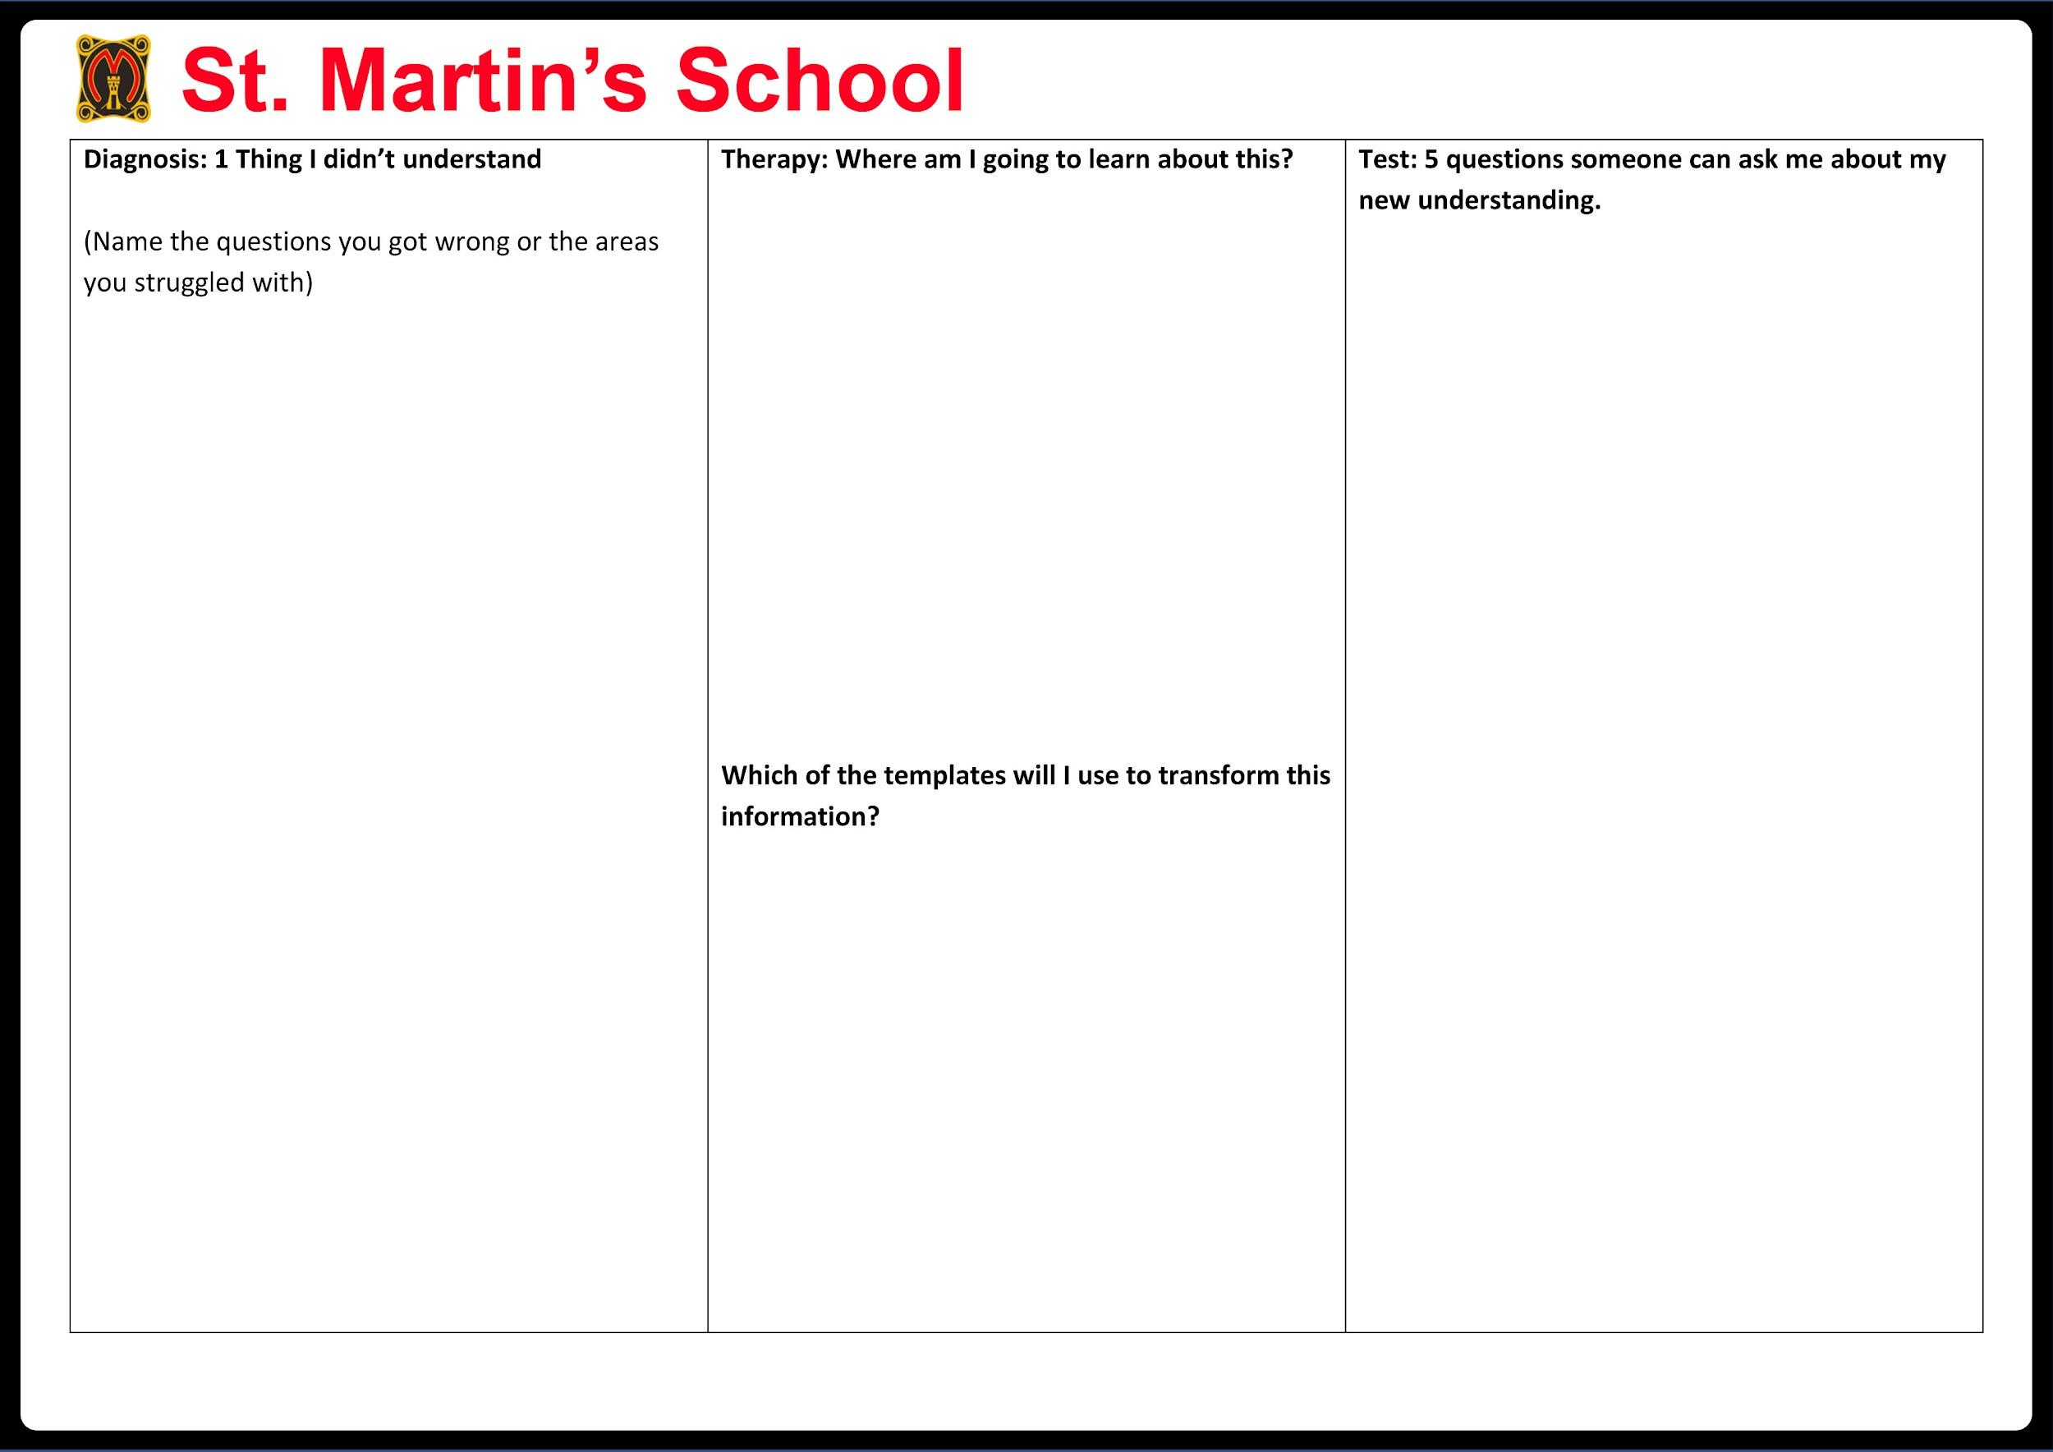
Independence Template

Slide 13
Upload Learn | Chunk it | Re learn it | Write it | Speak it
Process Apply | Transform it | Reduce it | Sort it | Link it
Download Retrieve | Restore it | Step it | Test it | Refine it

Slide 14
Upload / Learn

Slide 15
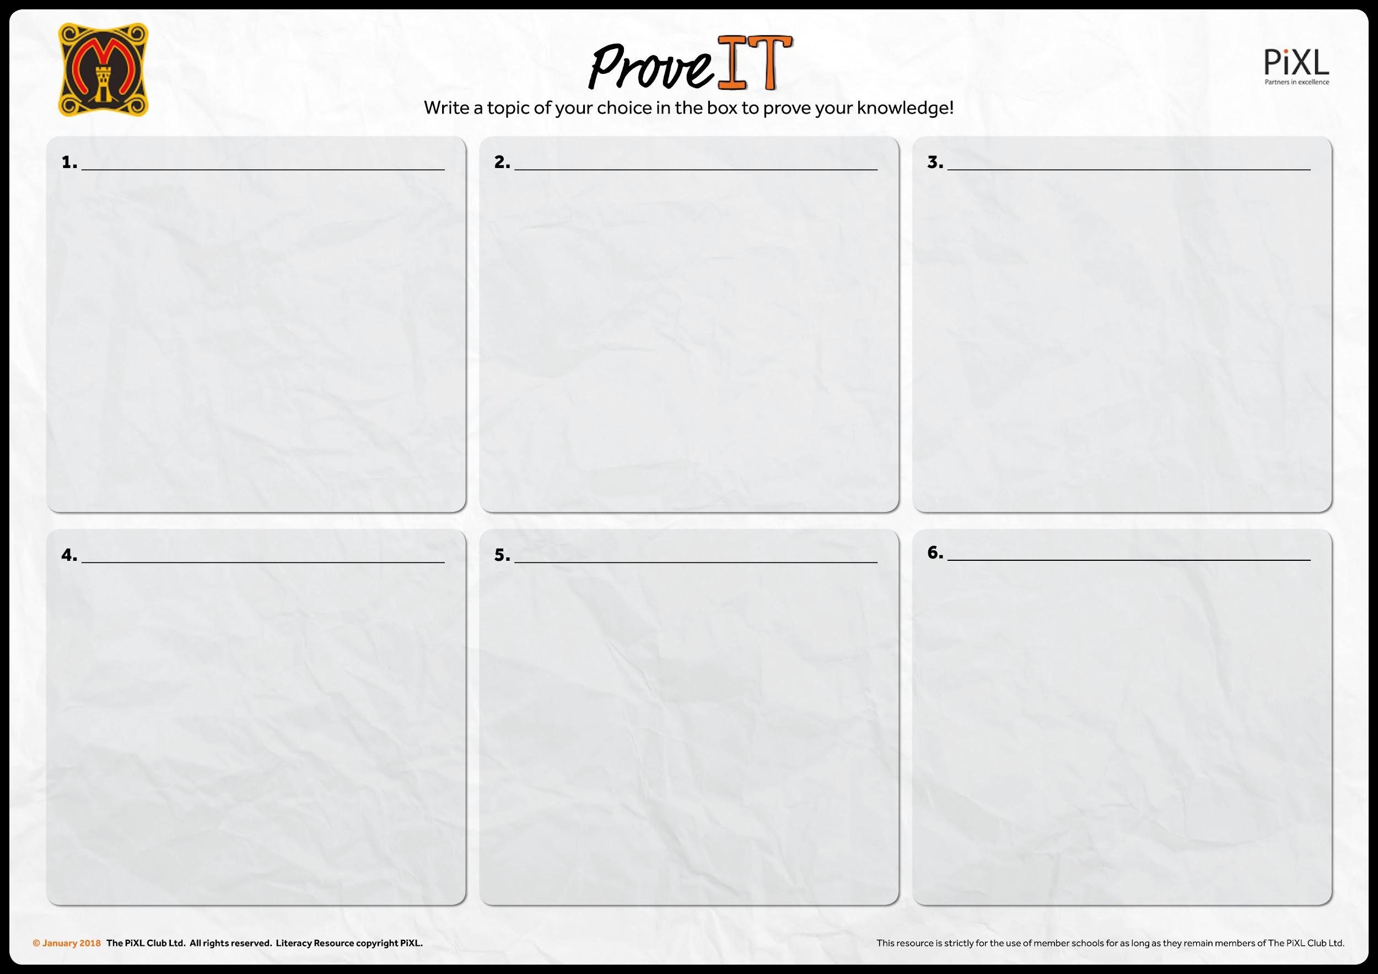

Slide 16
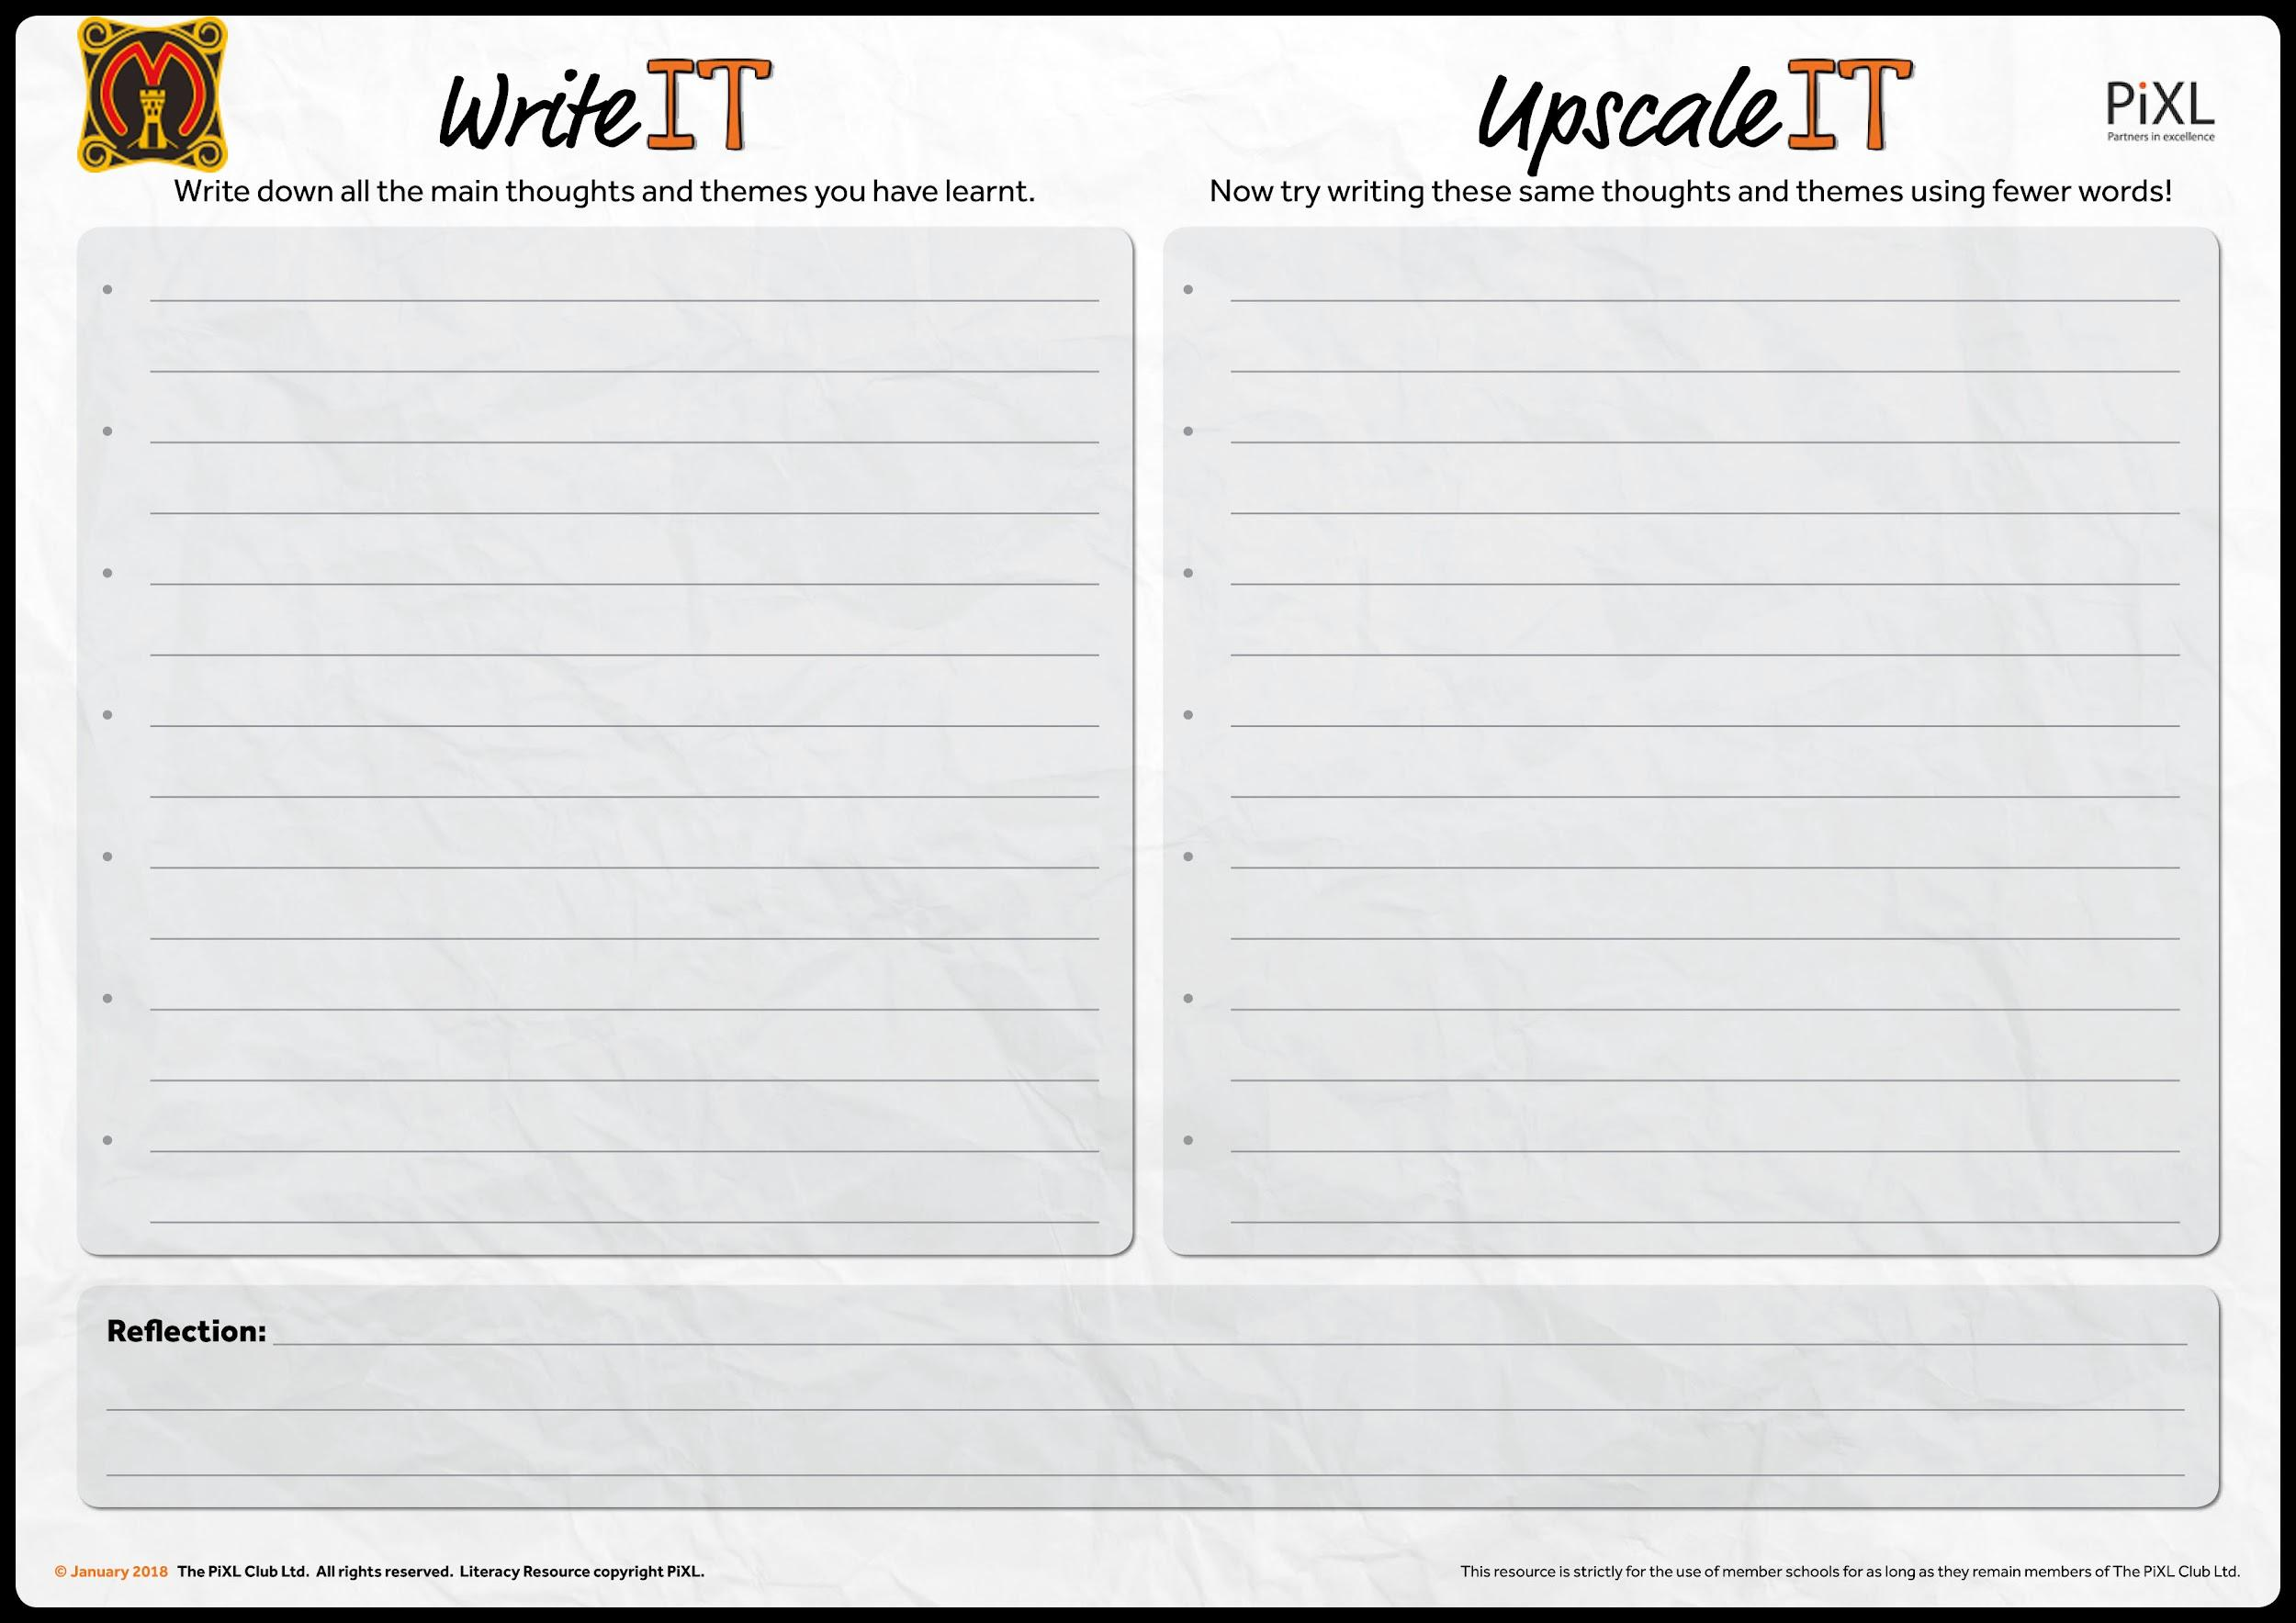

Slide 17
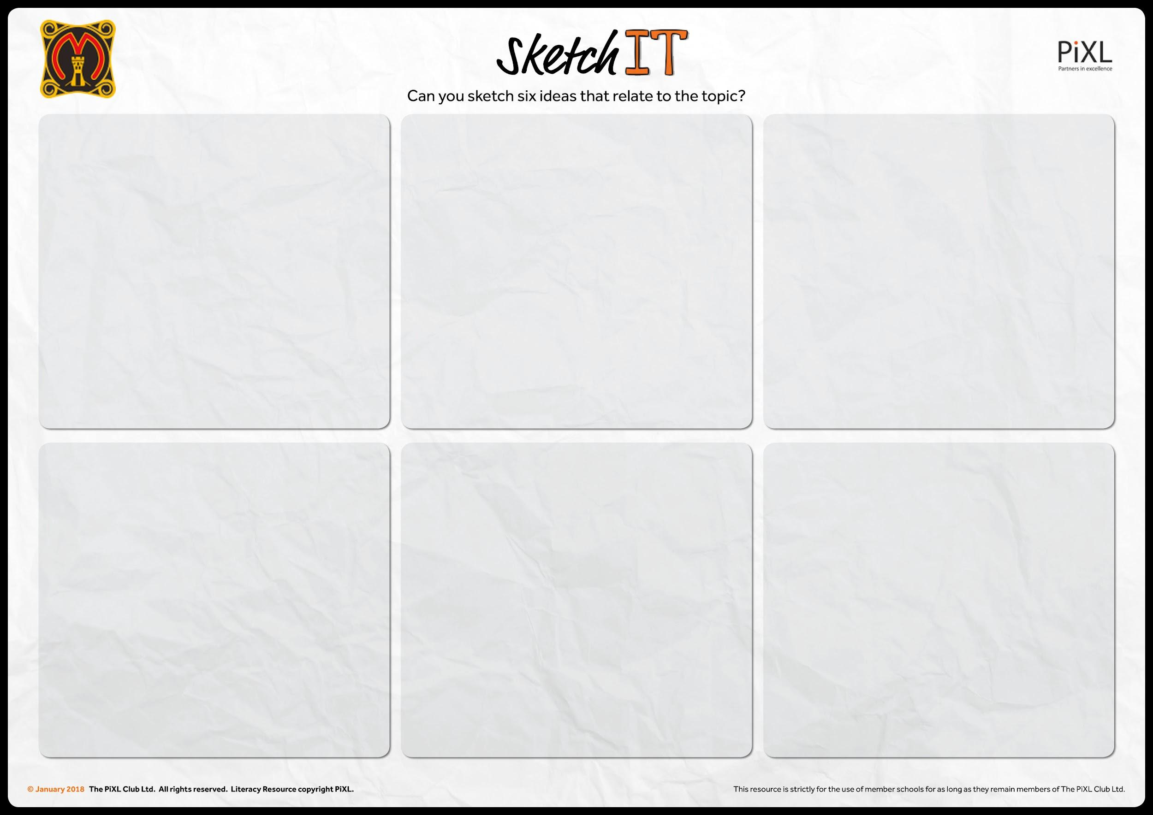

Slide 18
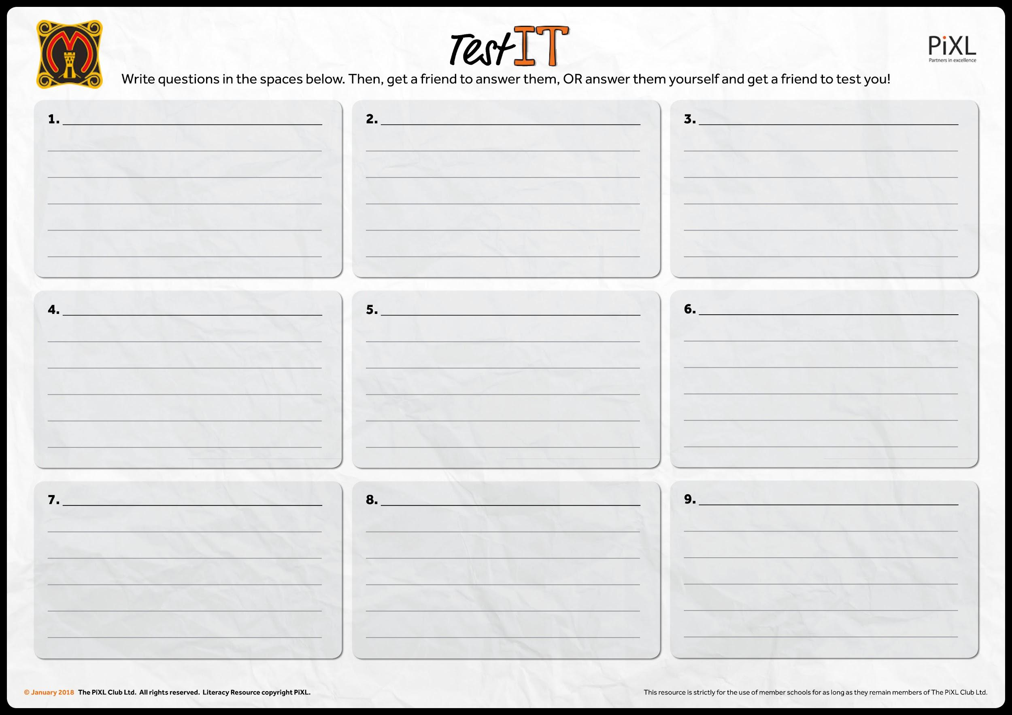
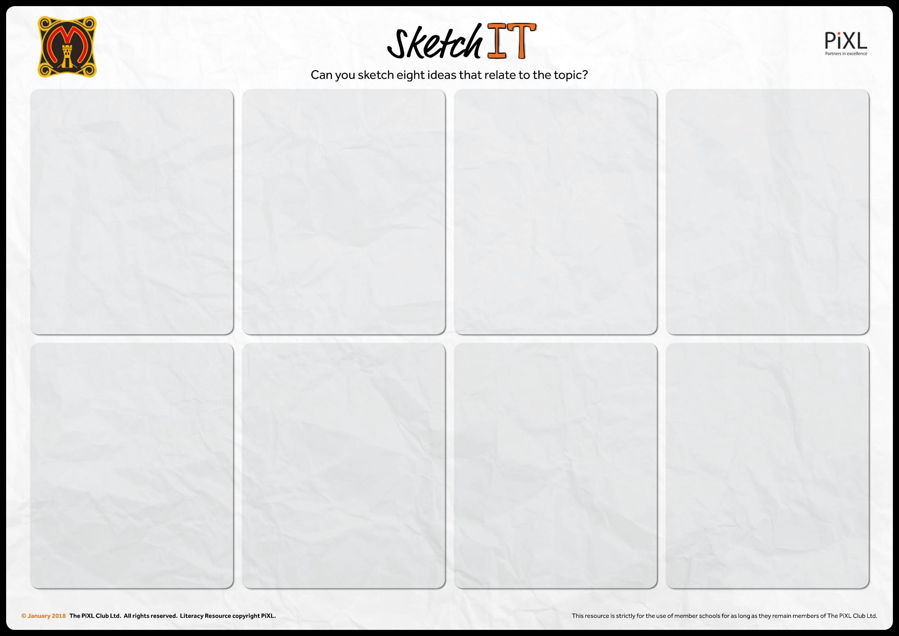

Slide 19


Slide 20
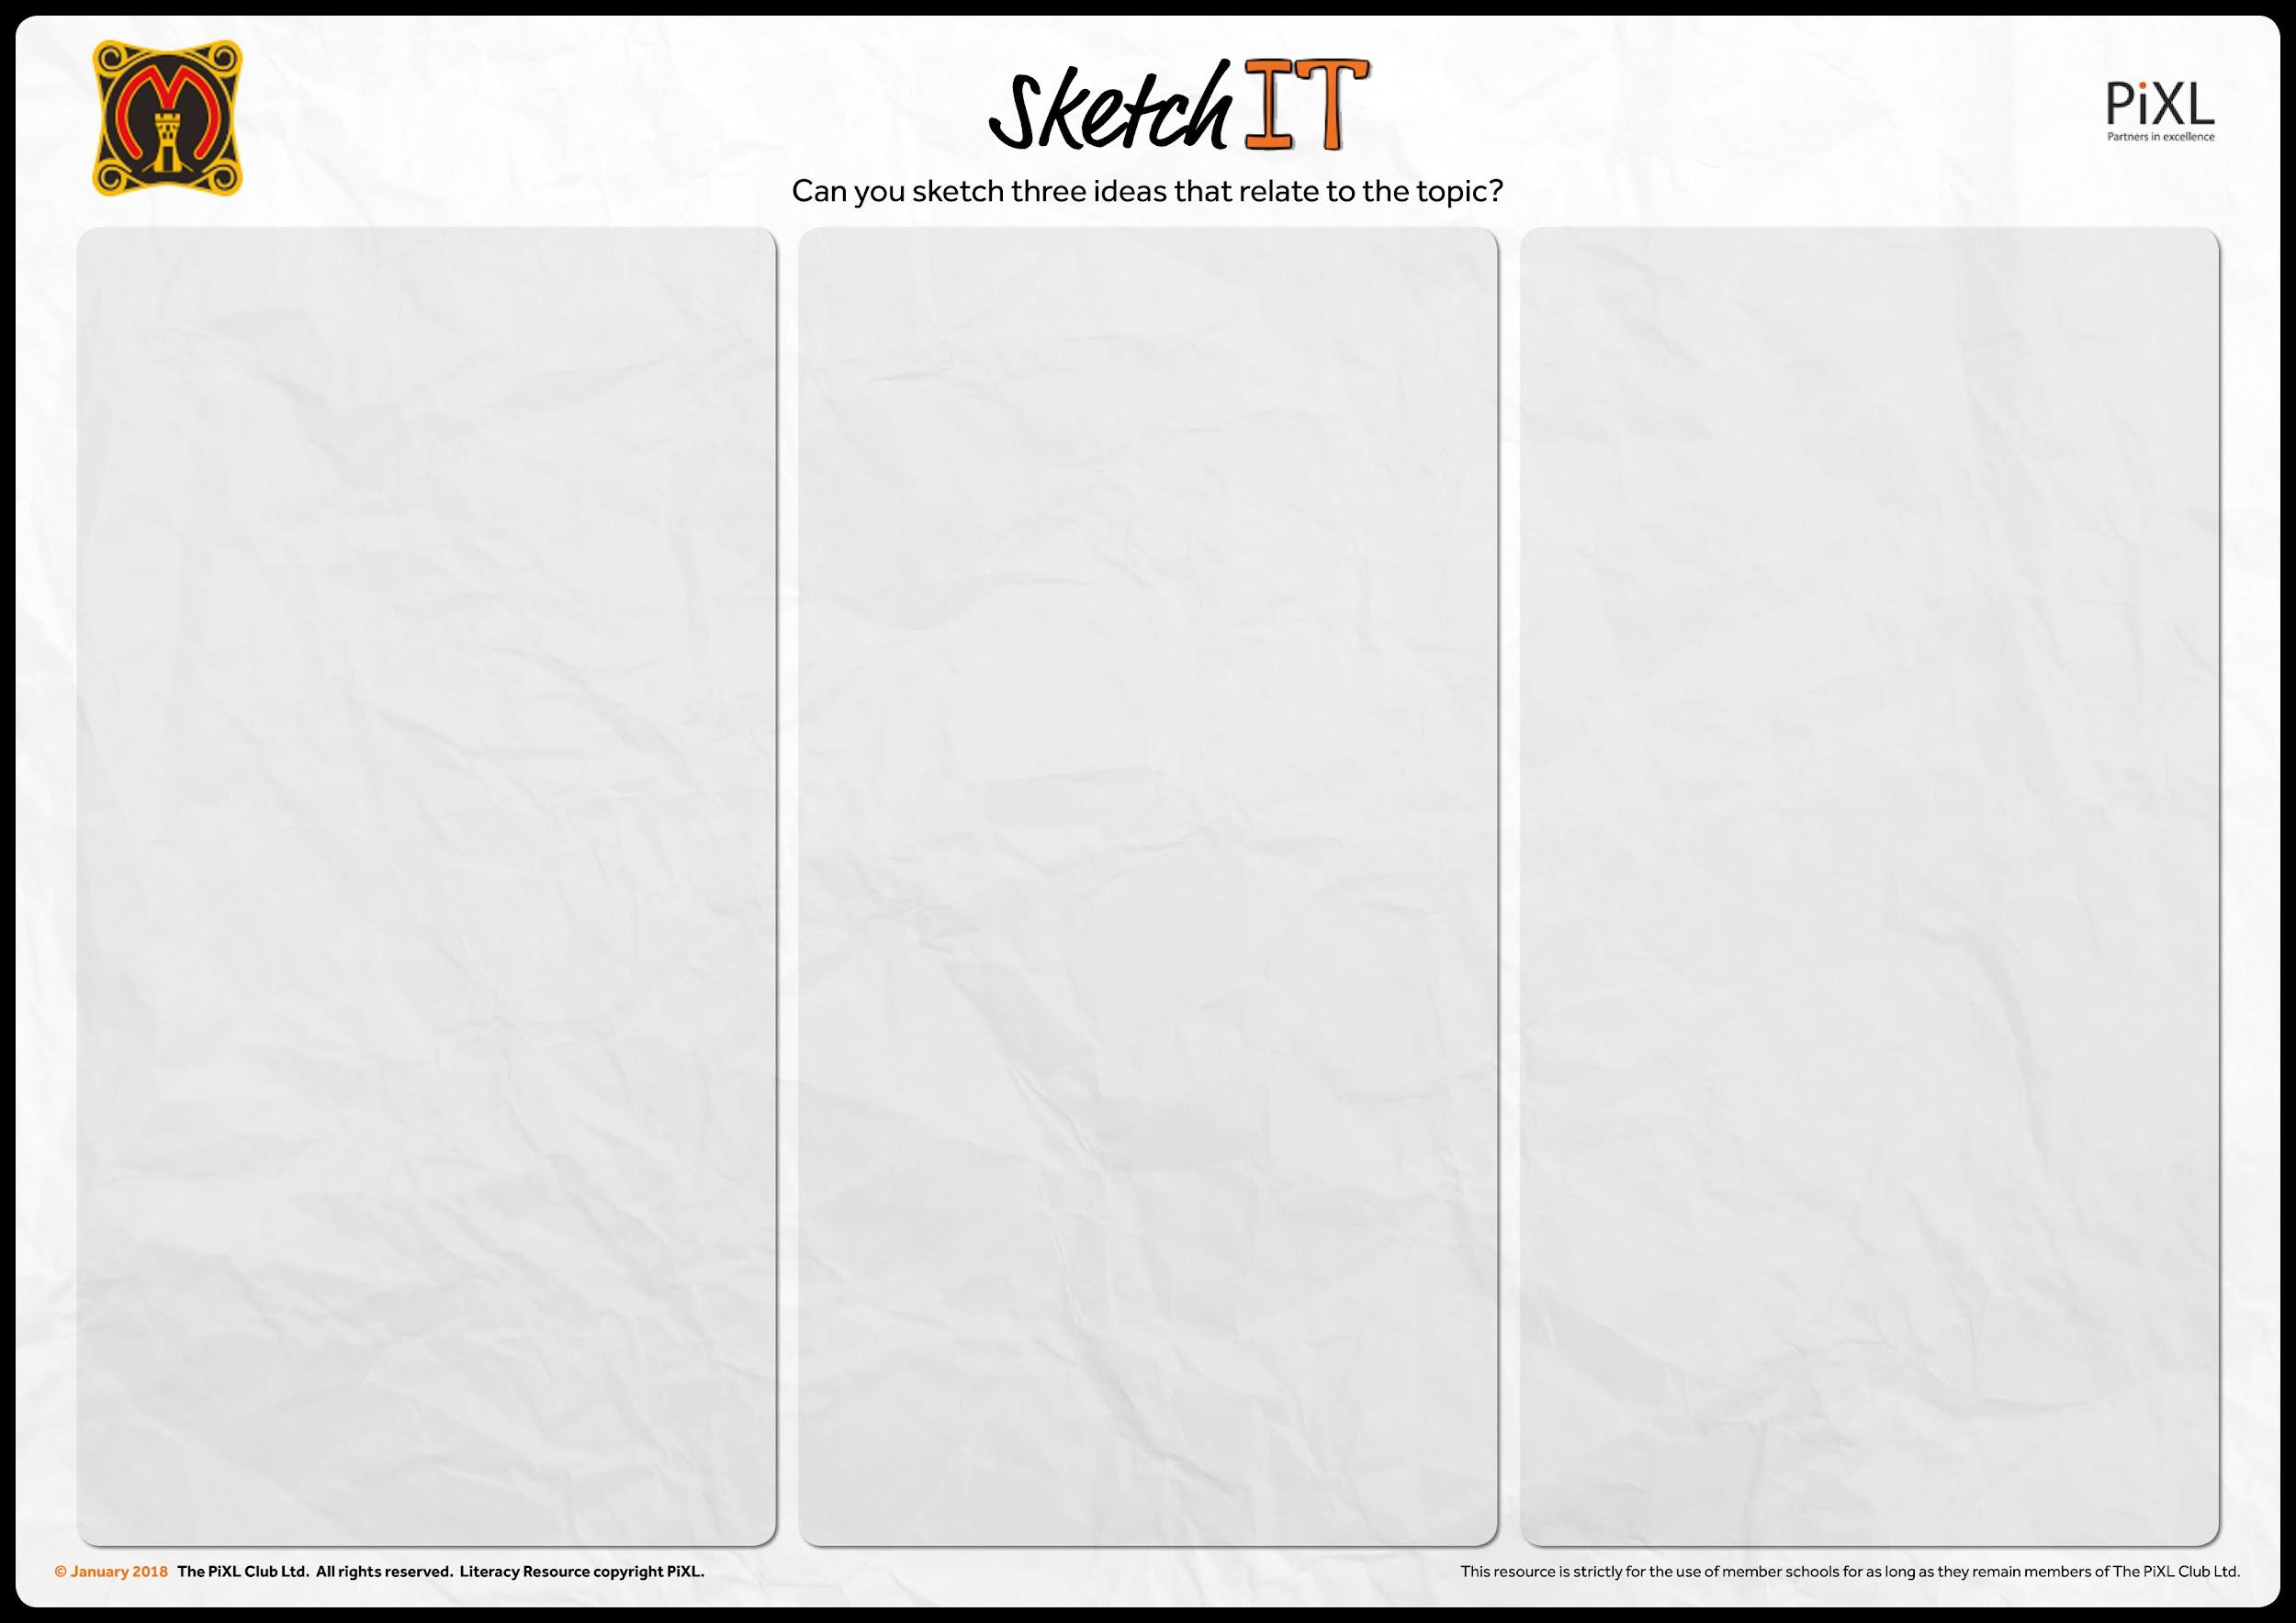

Slide 21
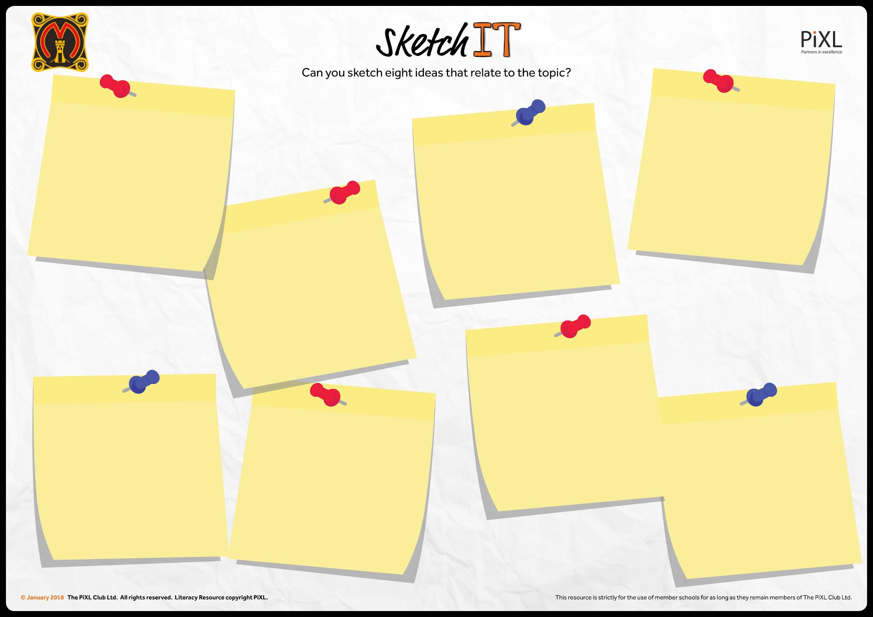

Slide 22
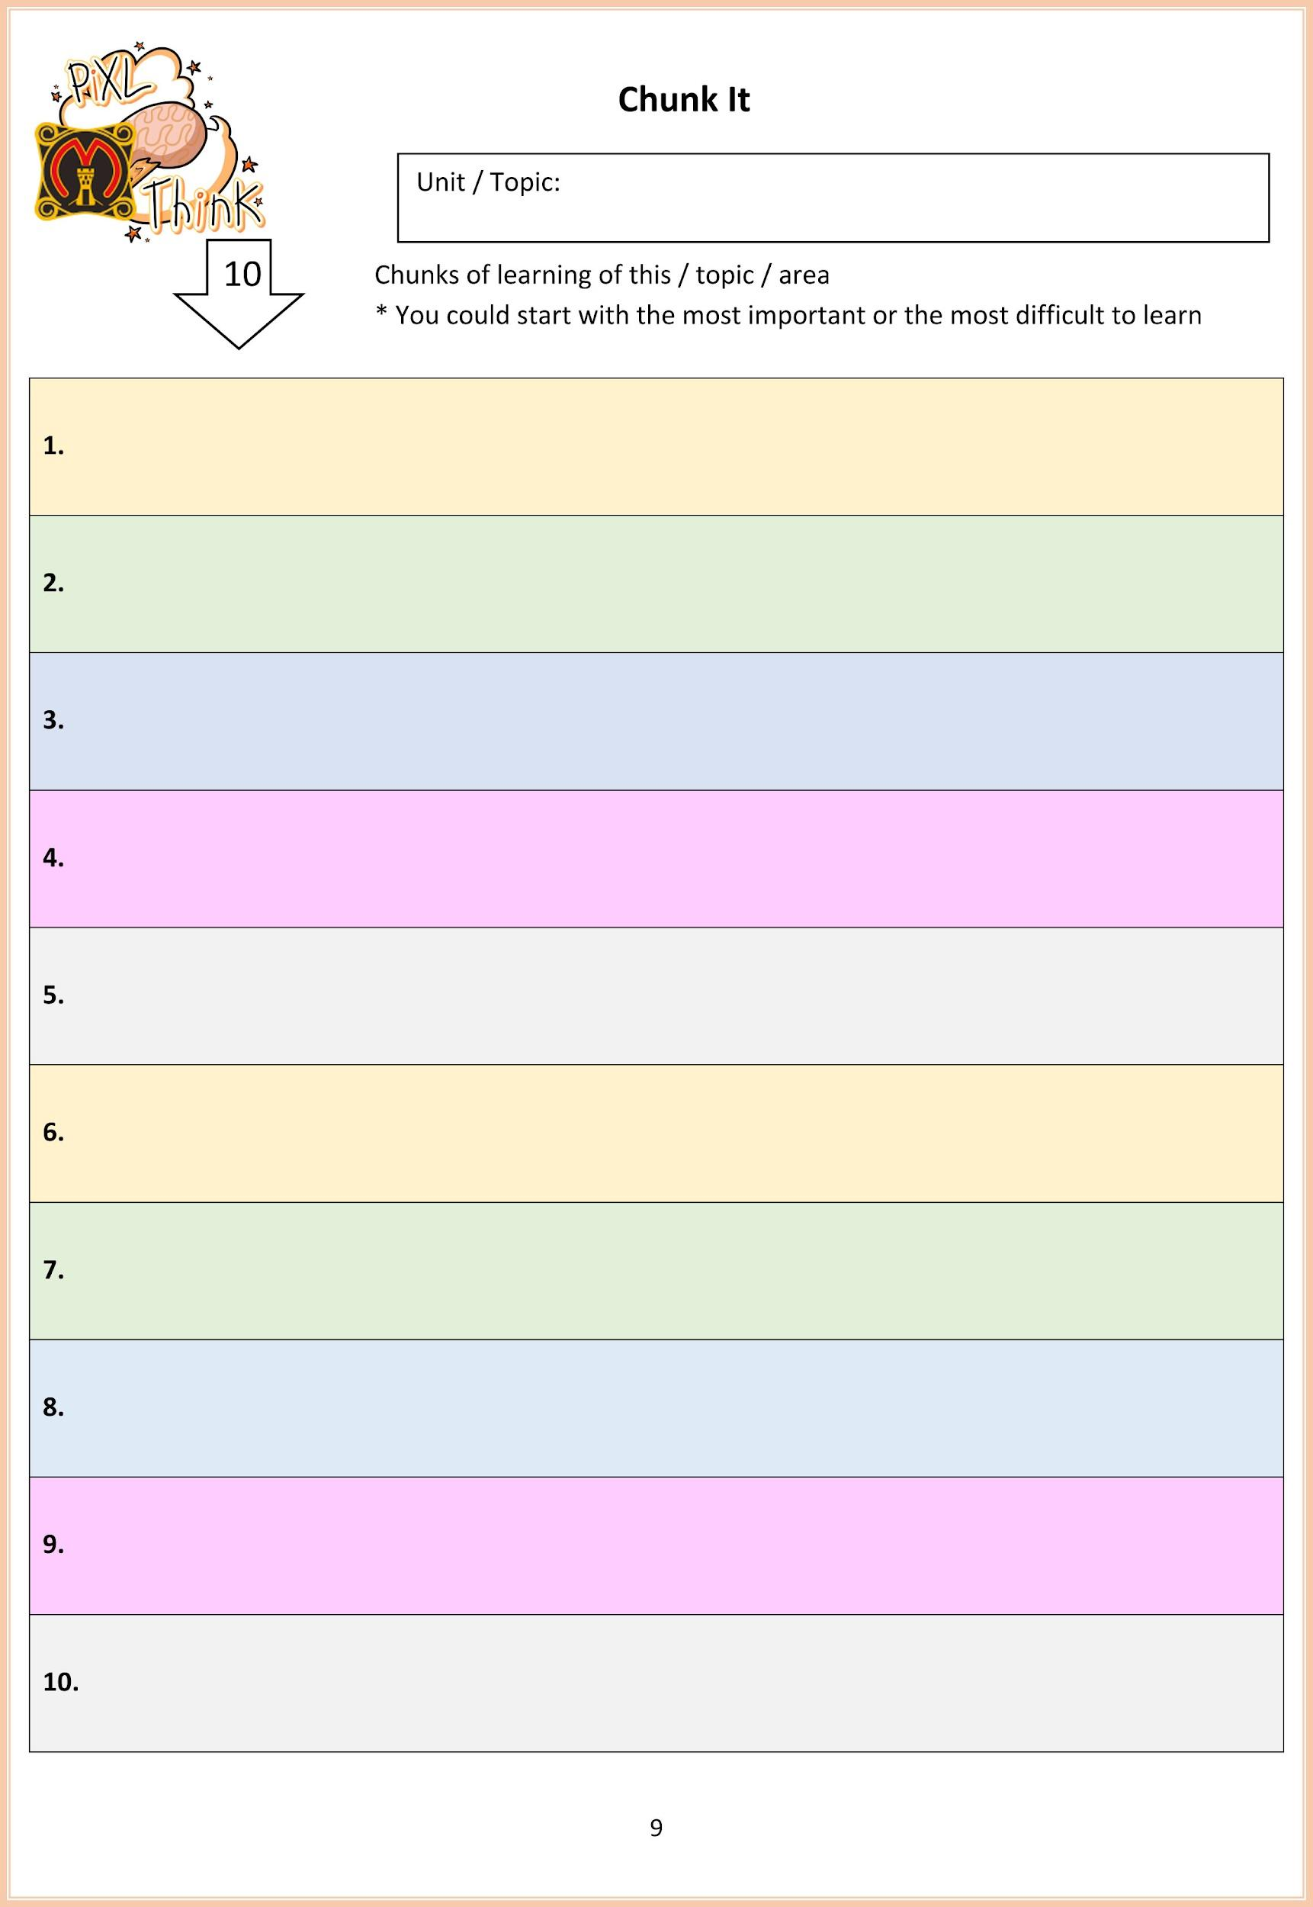

Slide 23
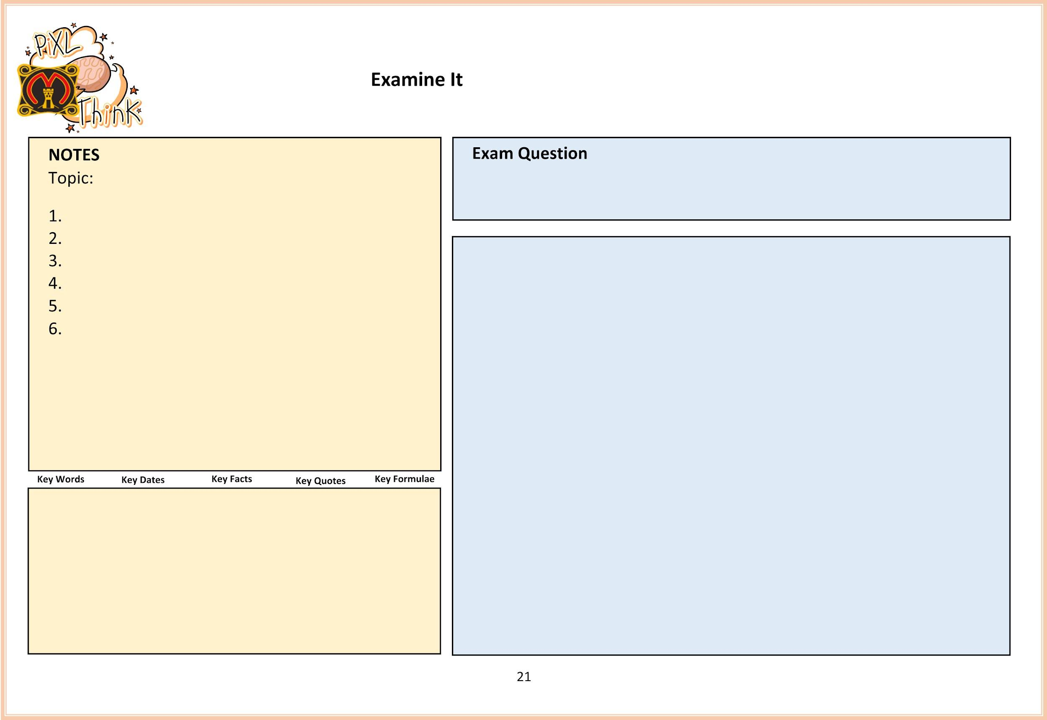

Slide 24
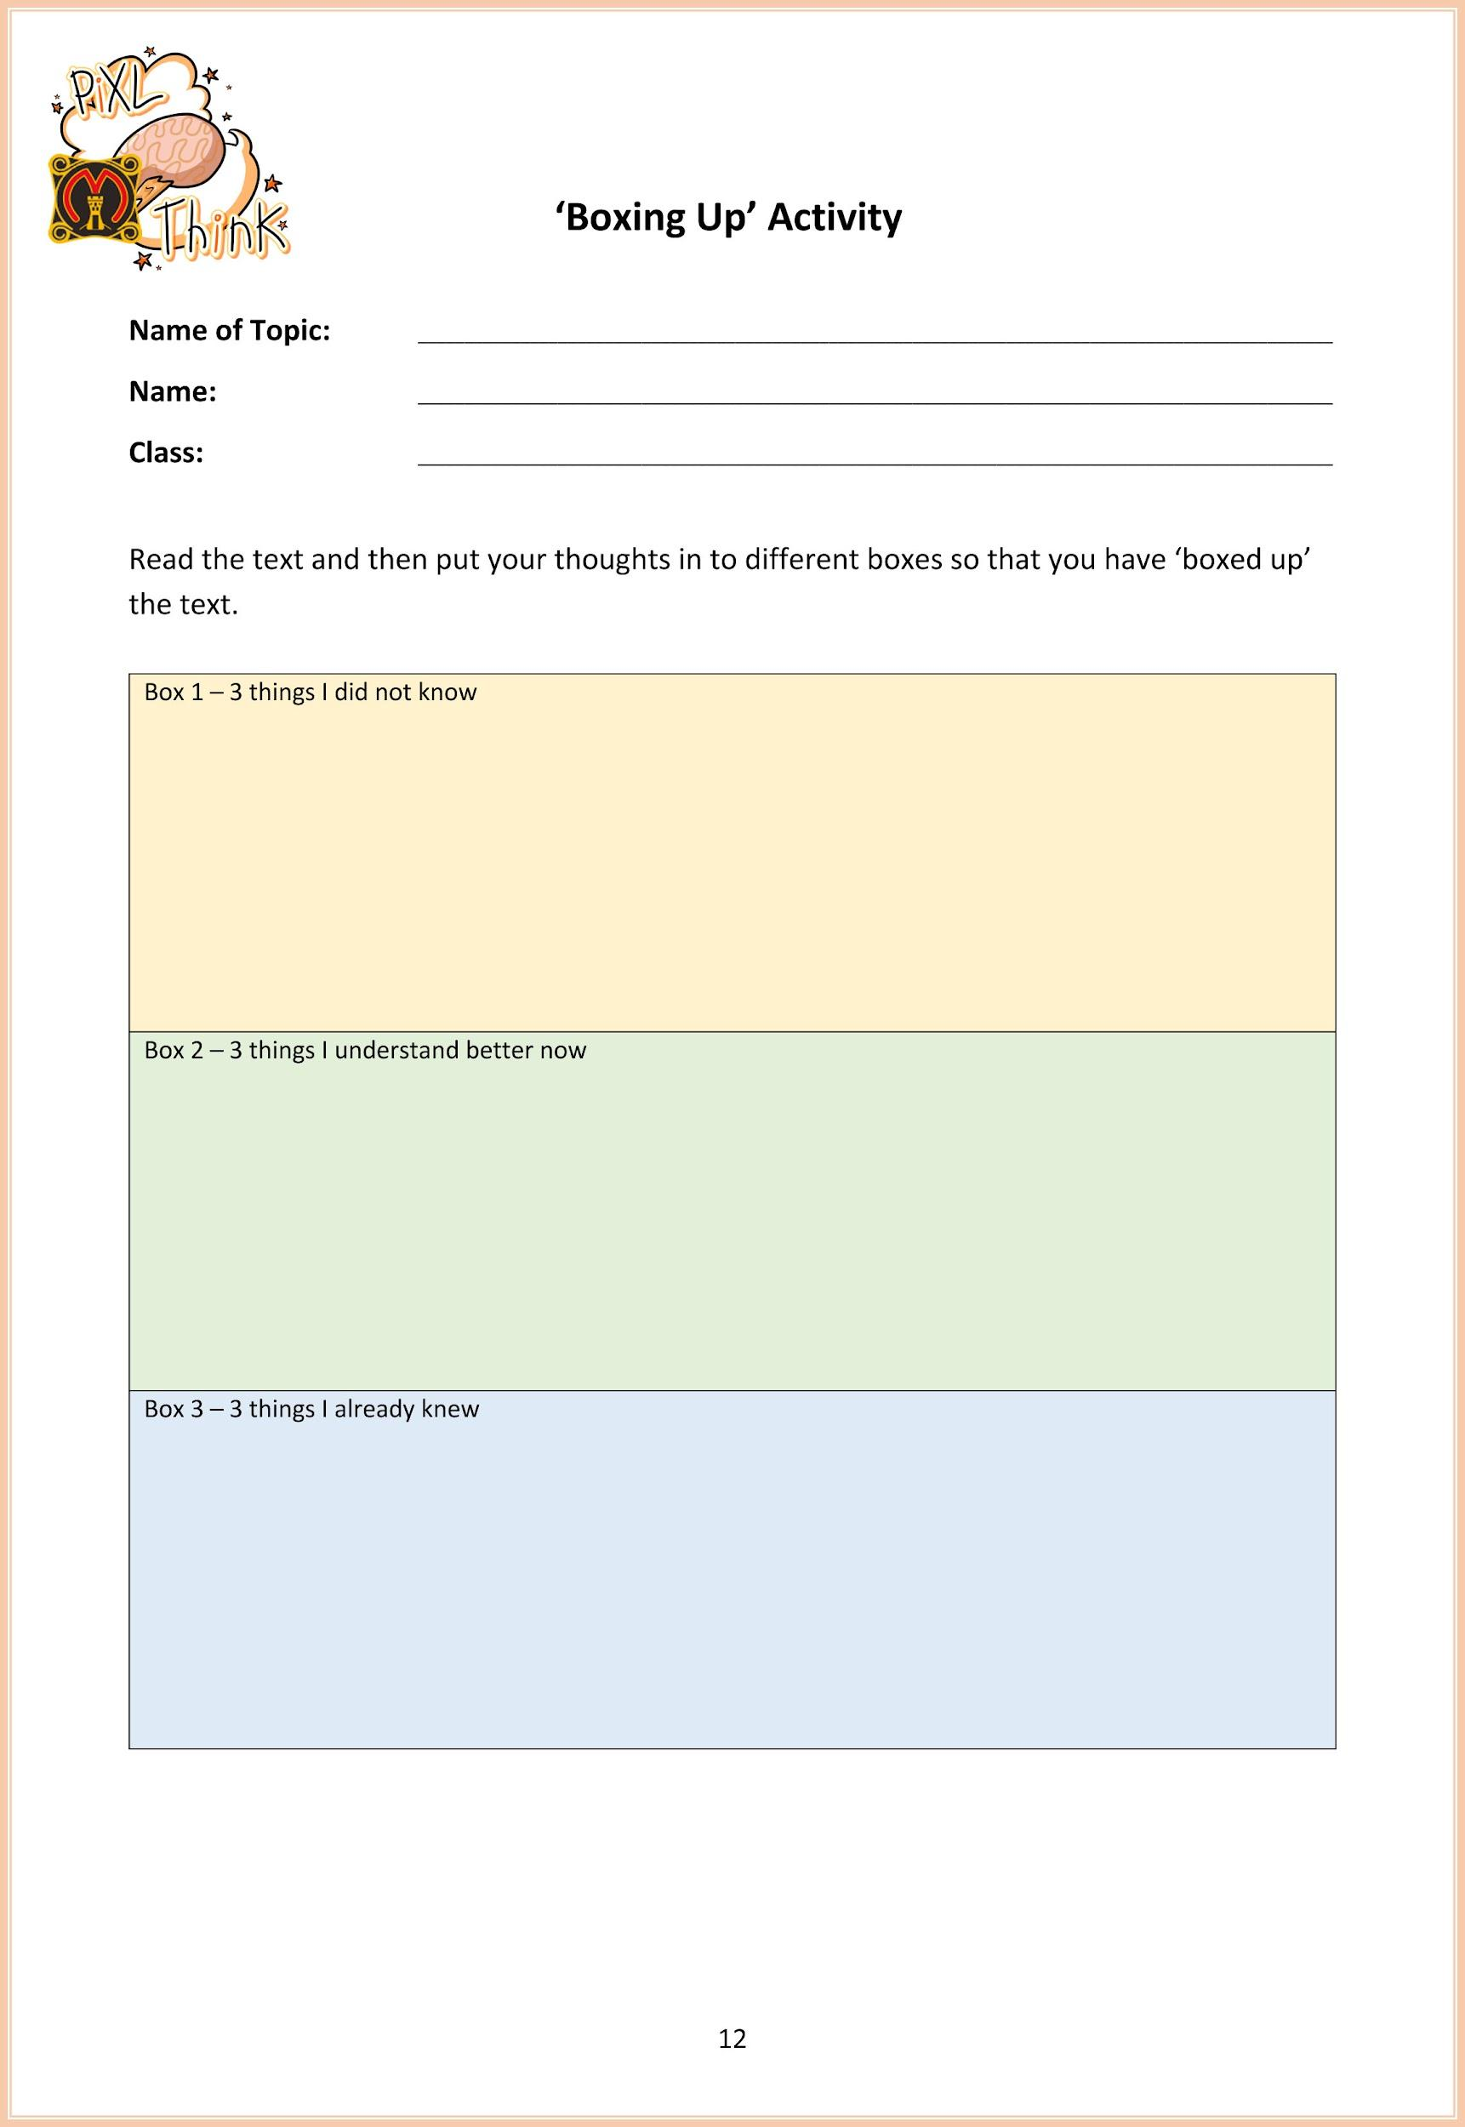

Slide 25
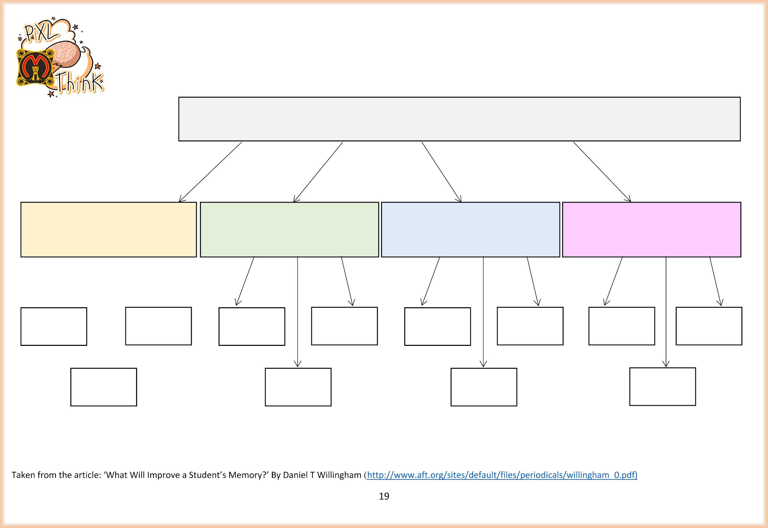

Slide 26
Process / Apply

Slide 27
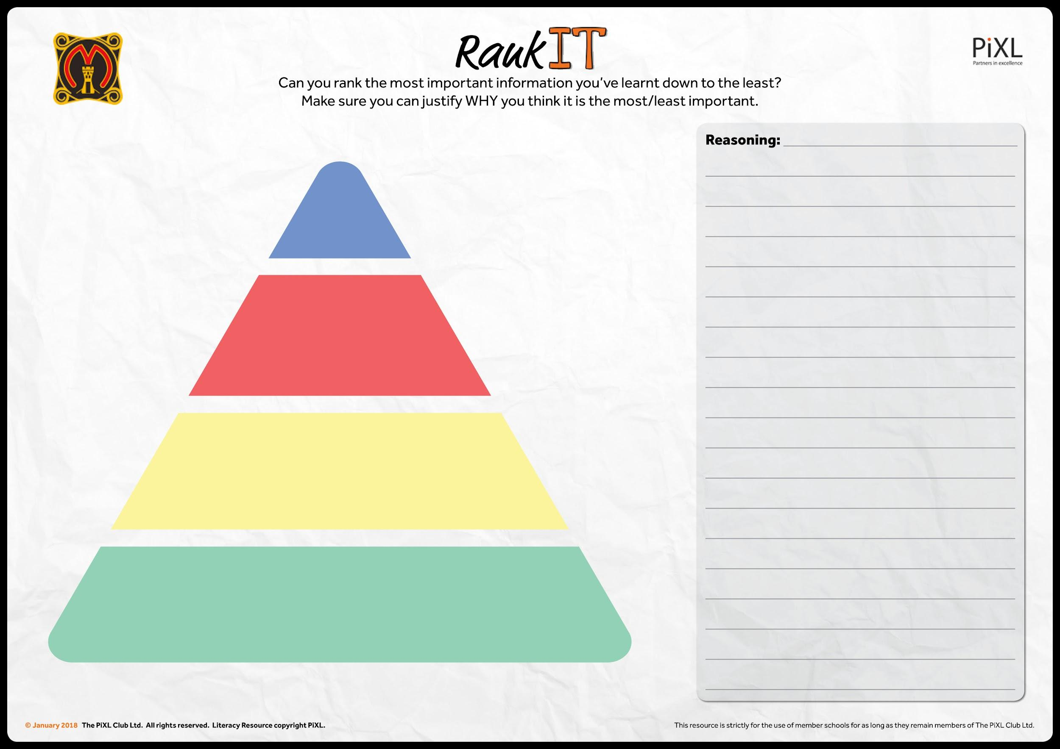

Slide 28
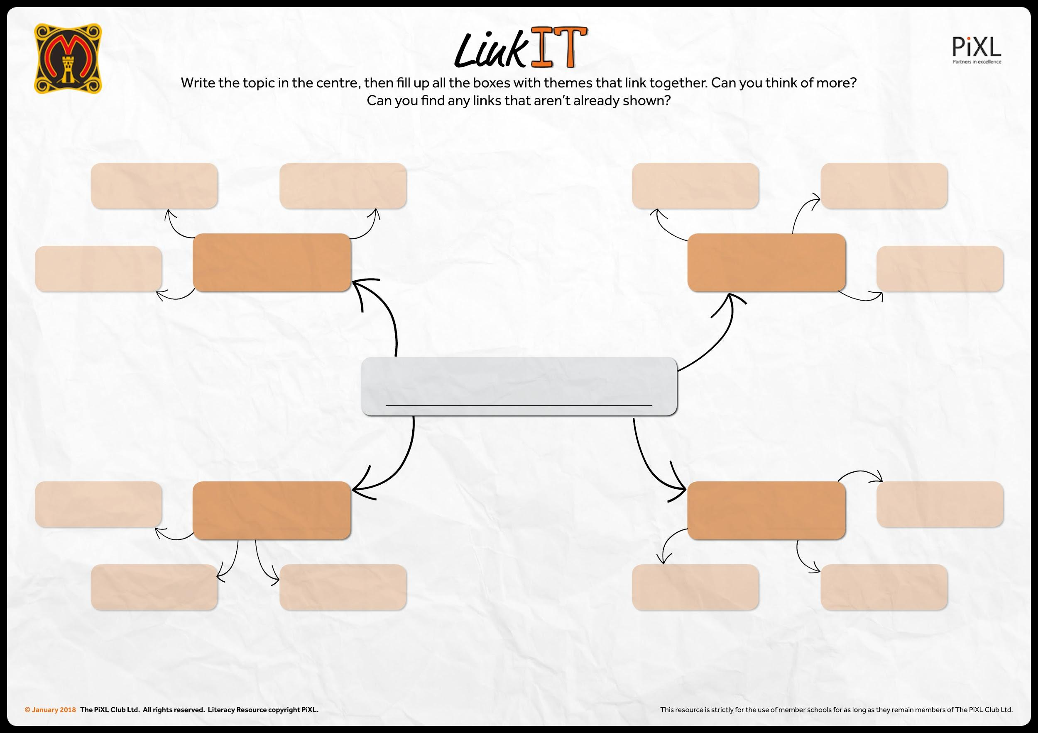

Slide 29
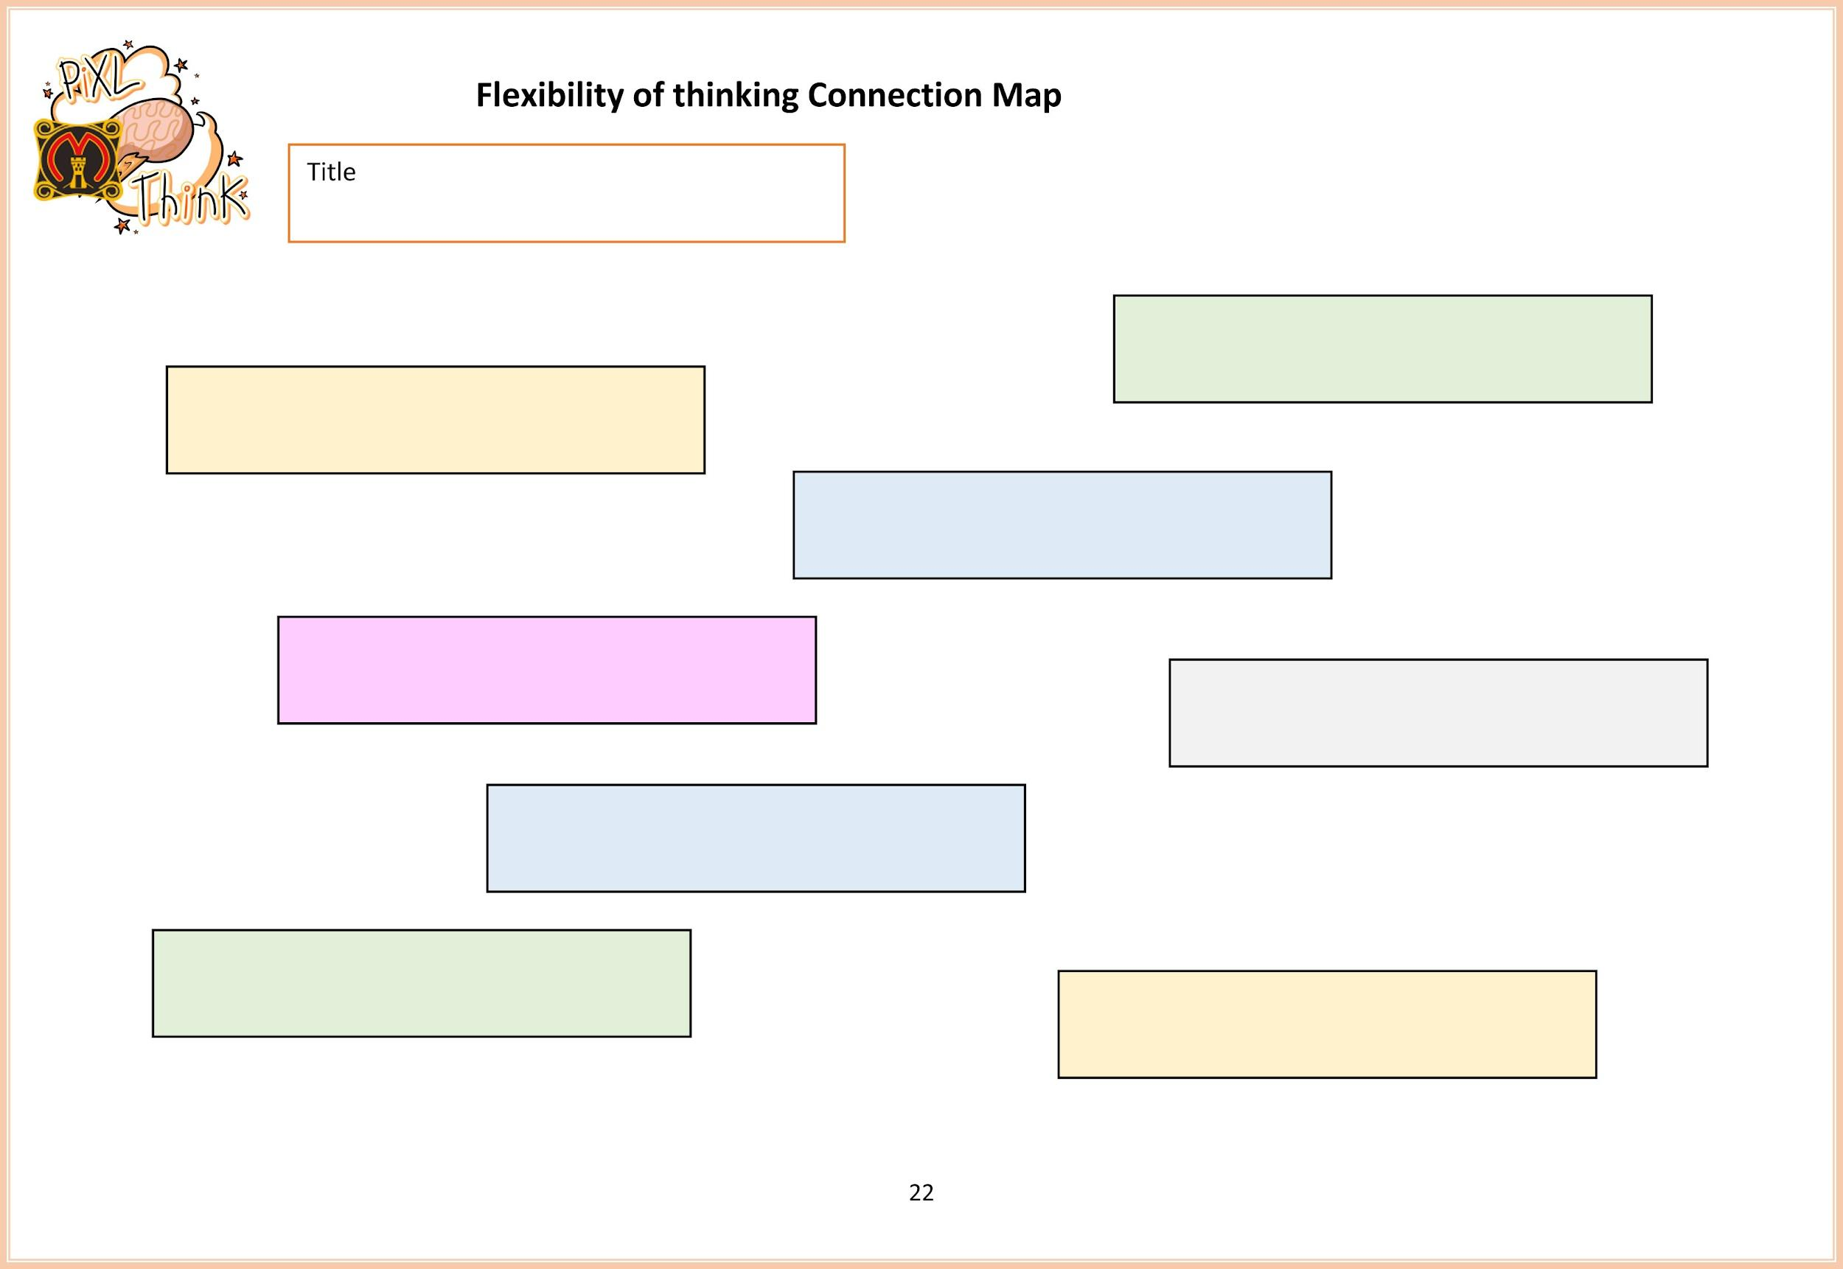

Slide 30
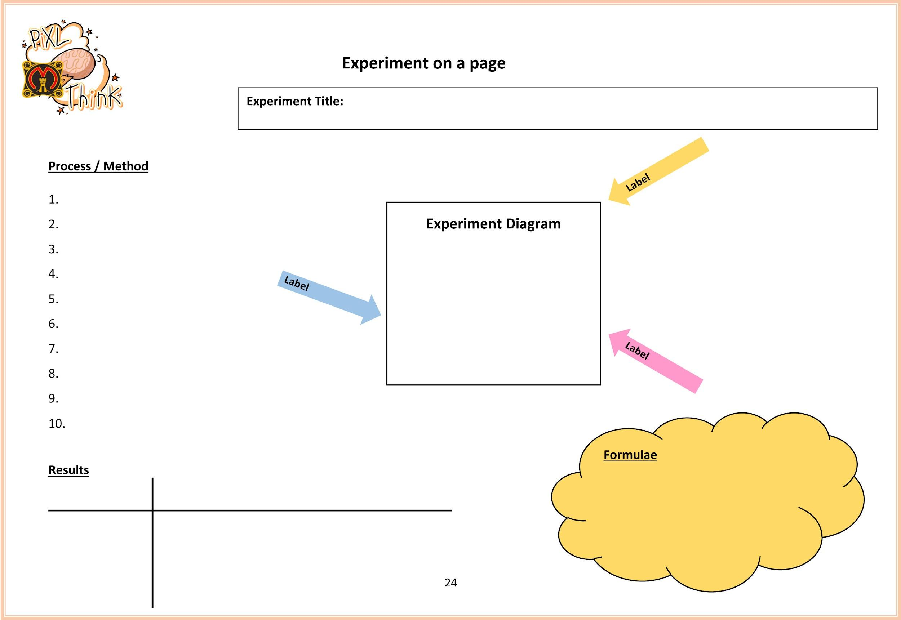

Slide 31
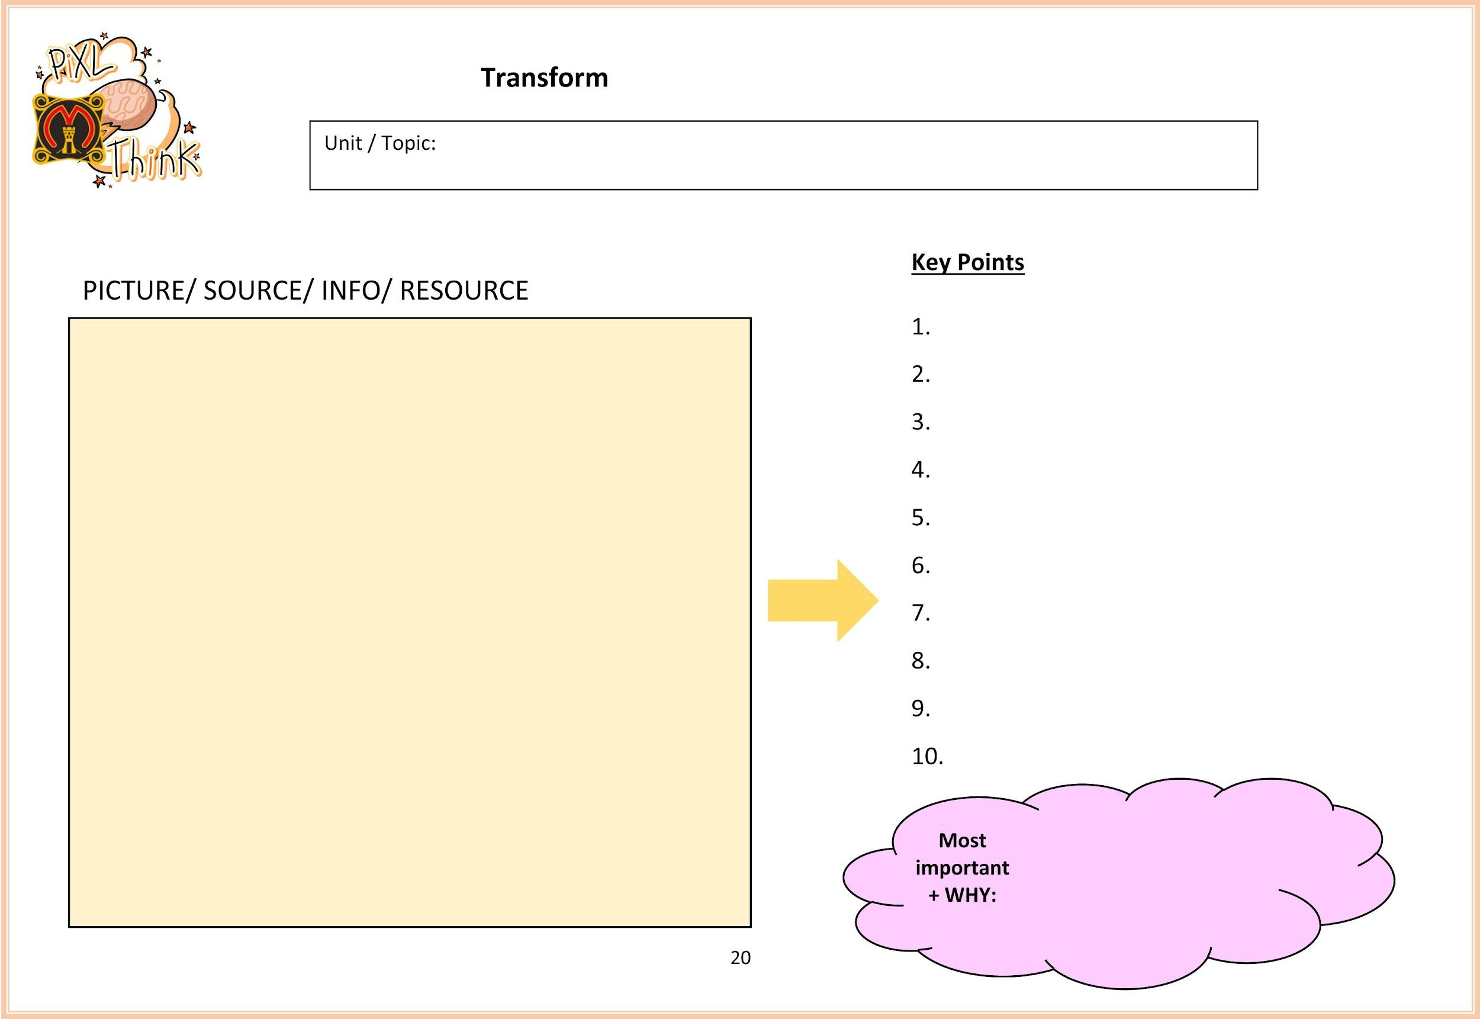

Slide 32
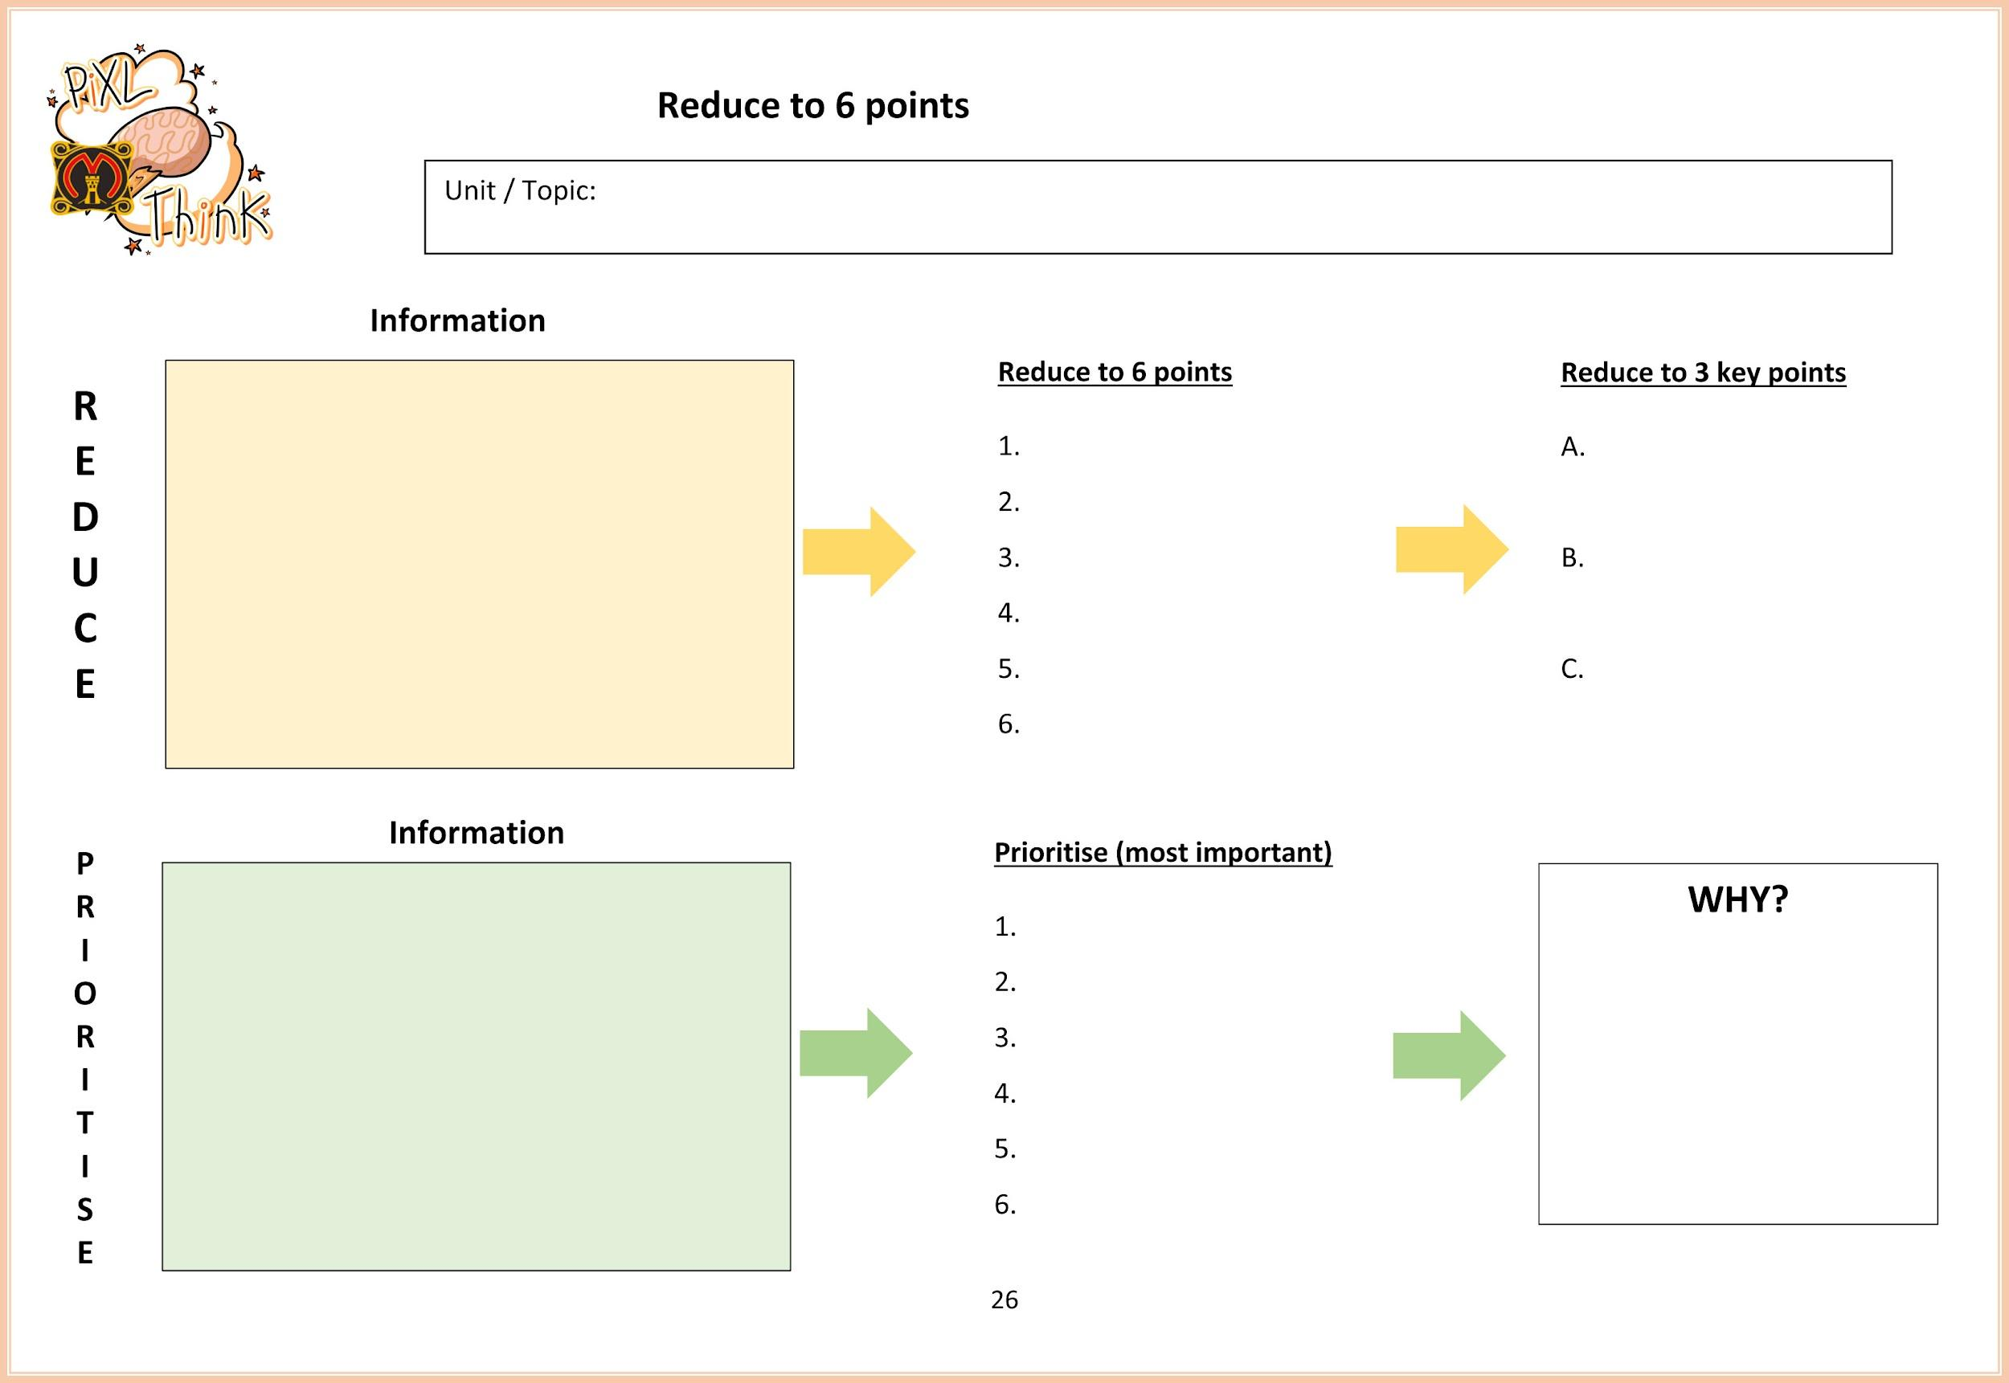

Slide 33
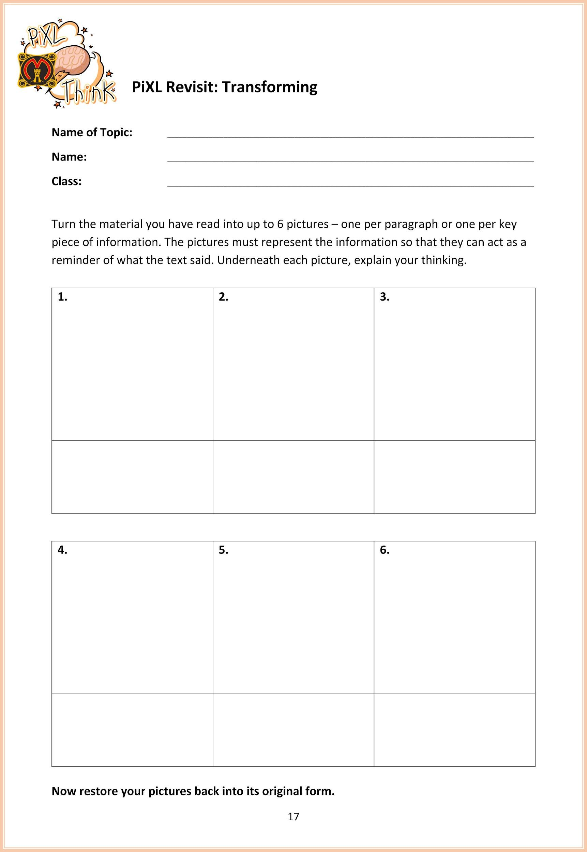

Slide 34
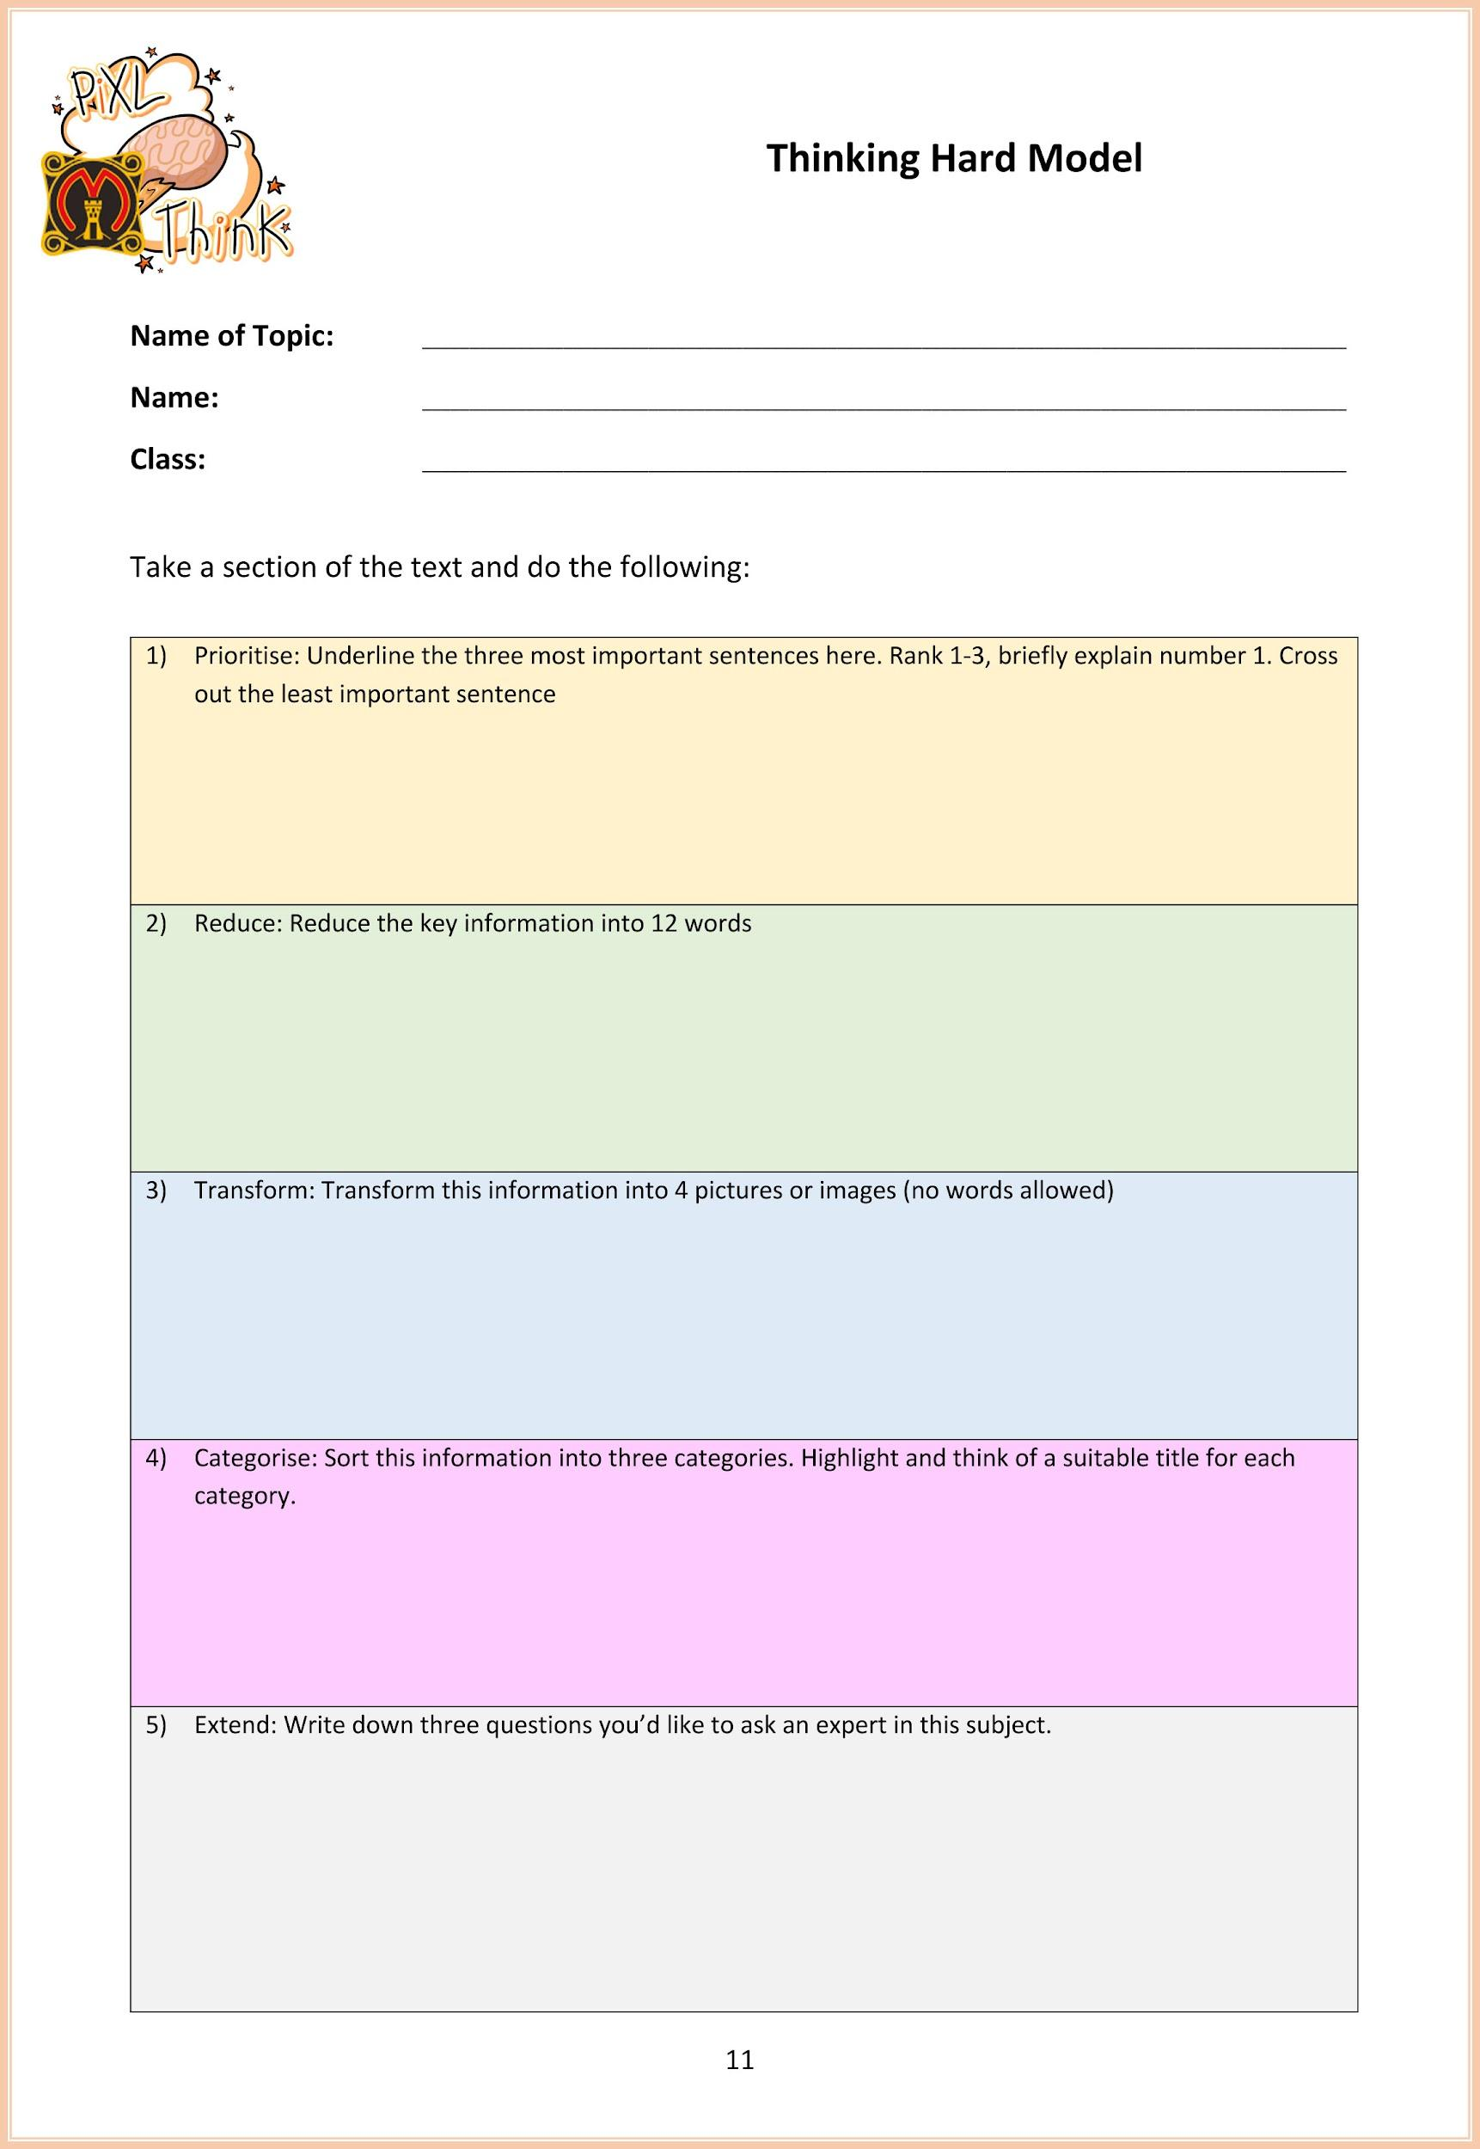

Slide 35
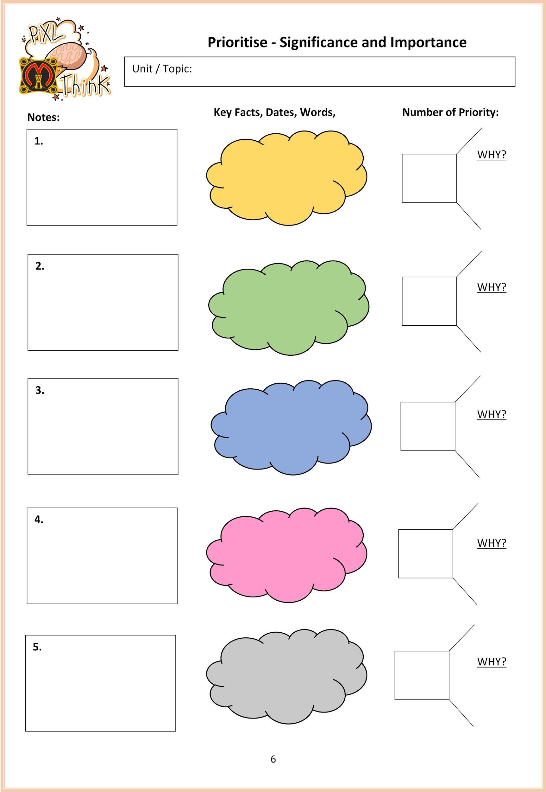
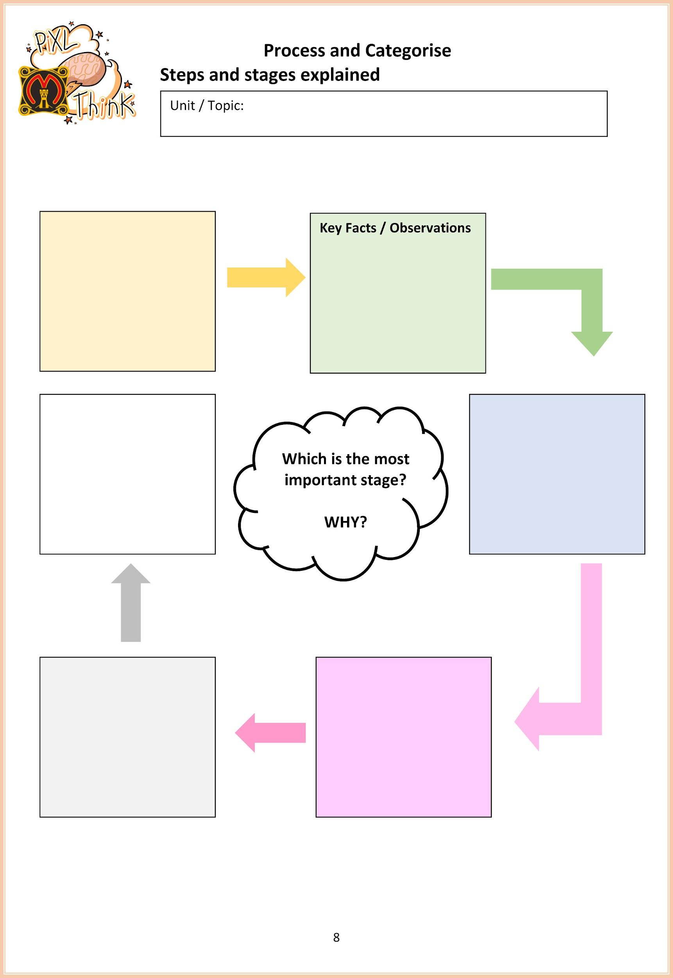

Slide 36
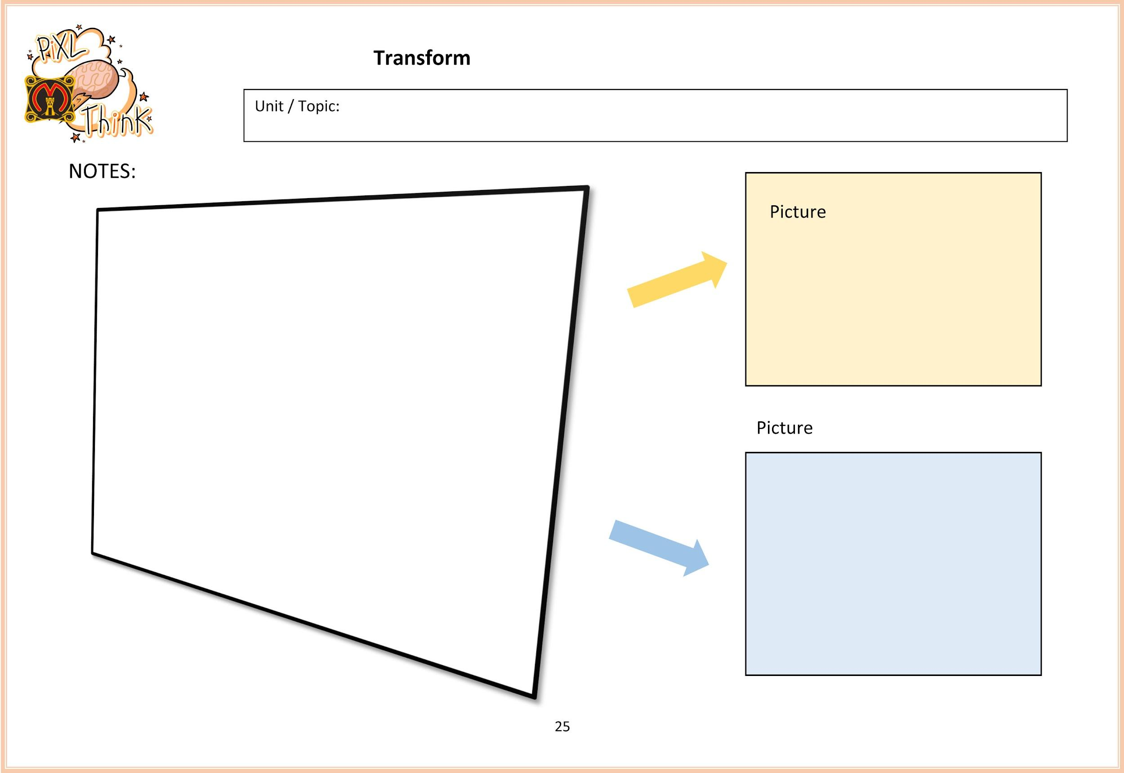

Slide 37
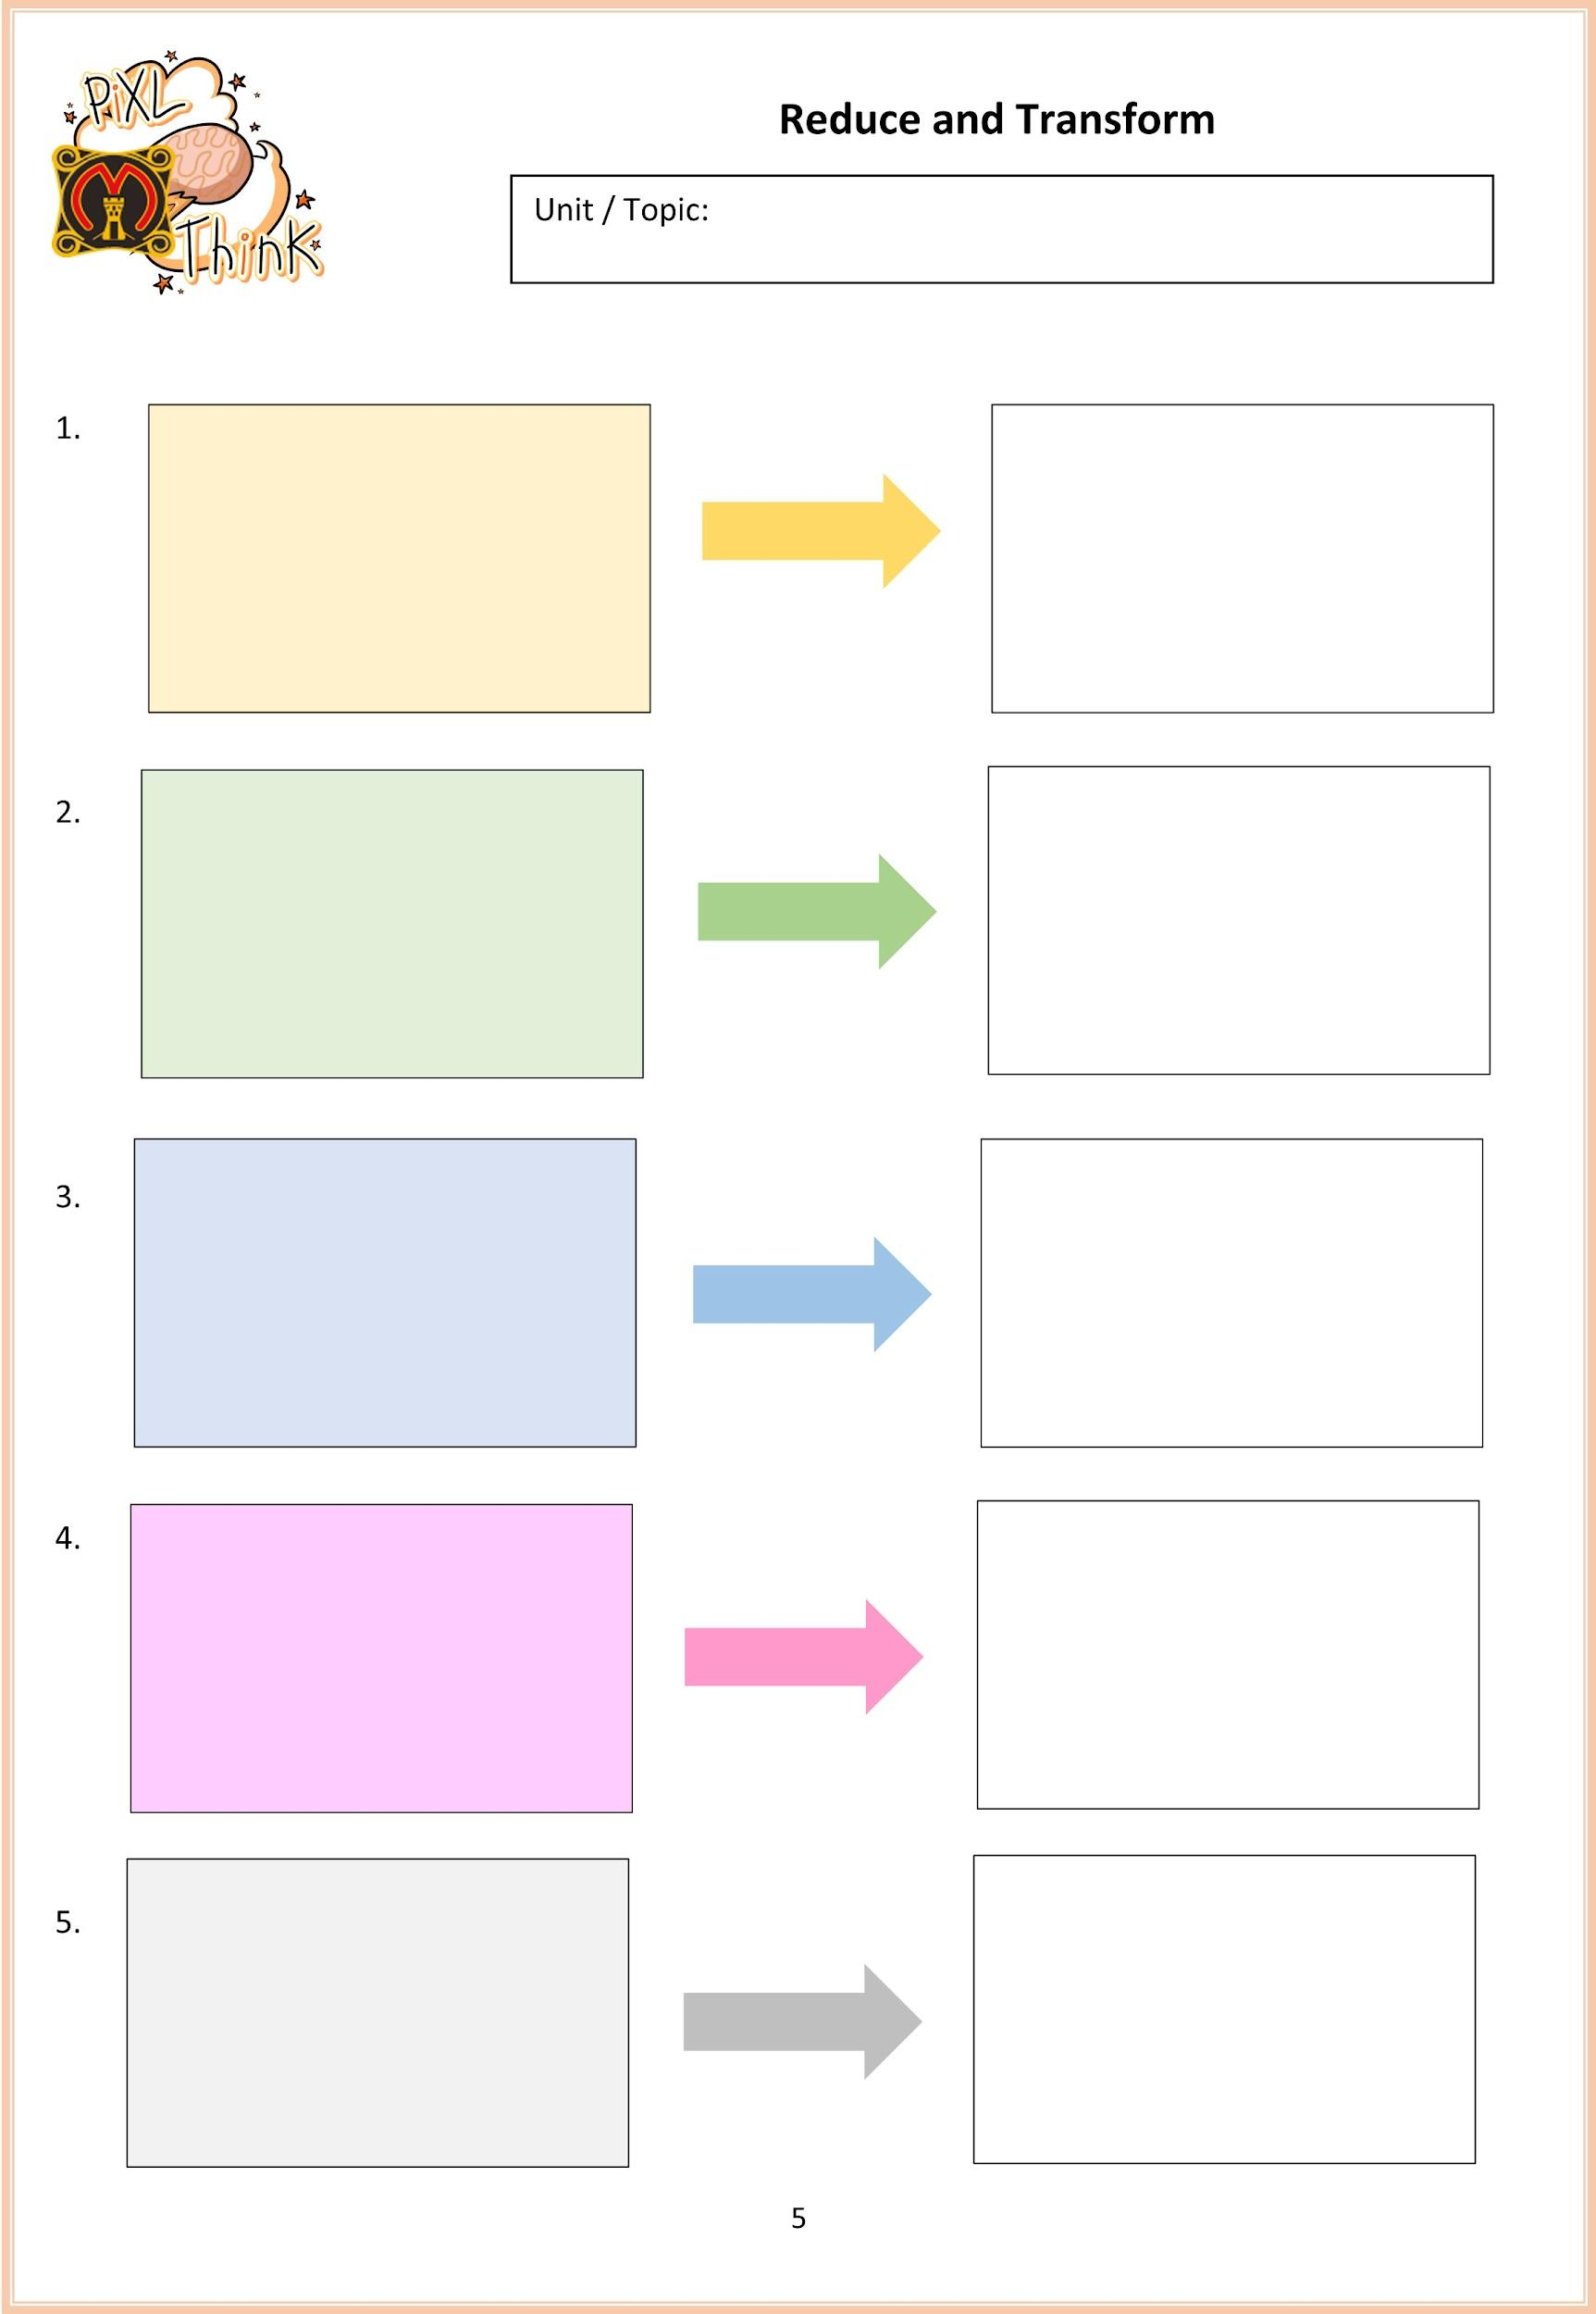

Slide 38
Download / Retrieve

Slide 40
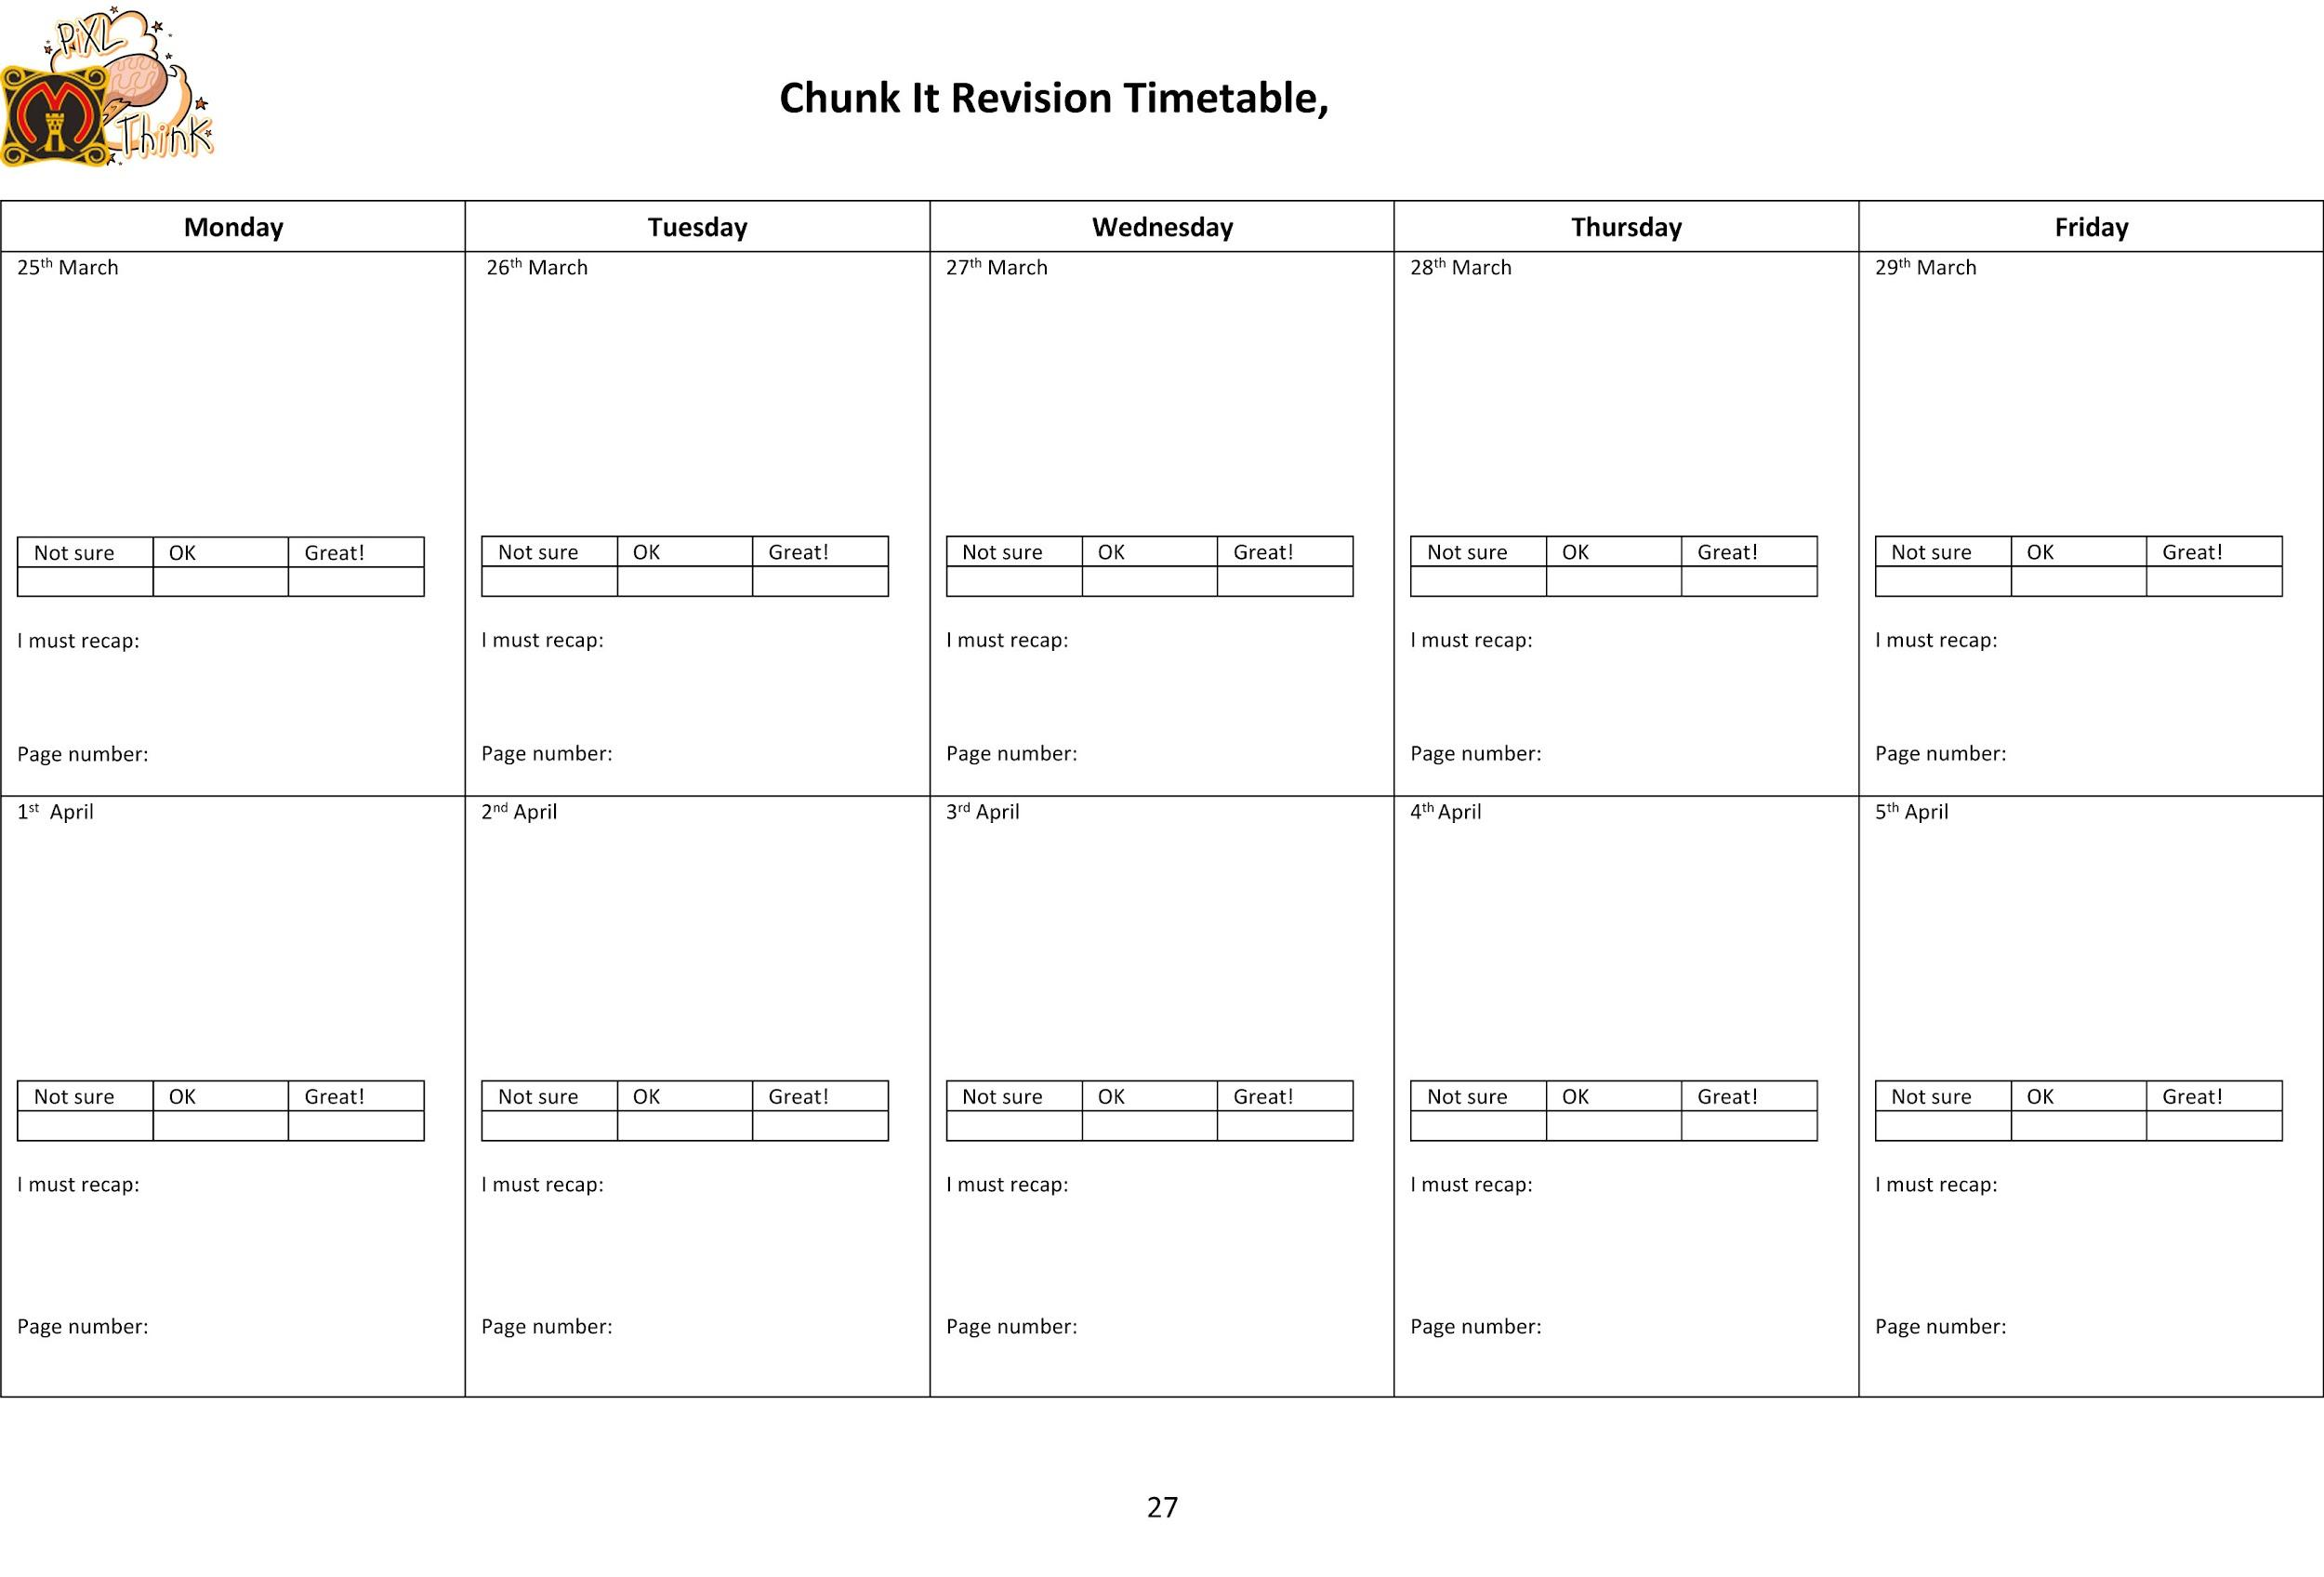

Slide 41
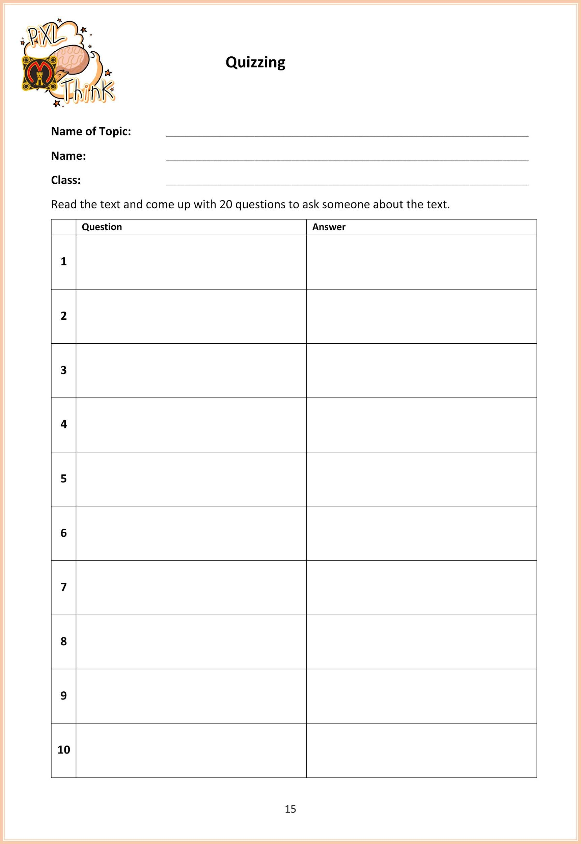

Slide 42
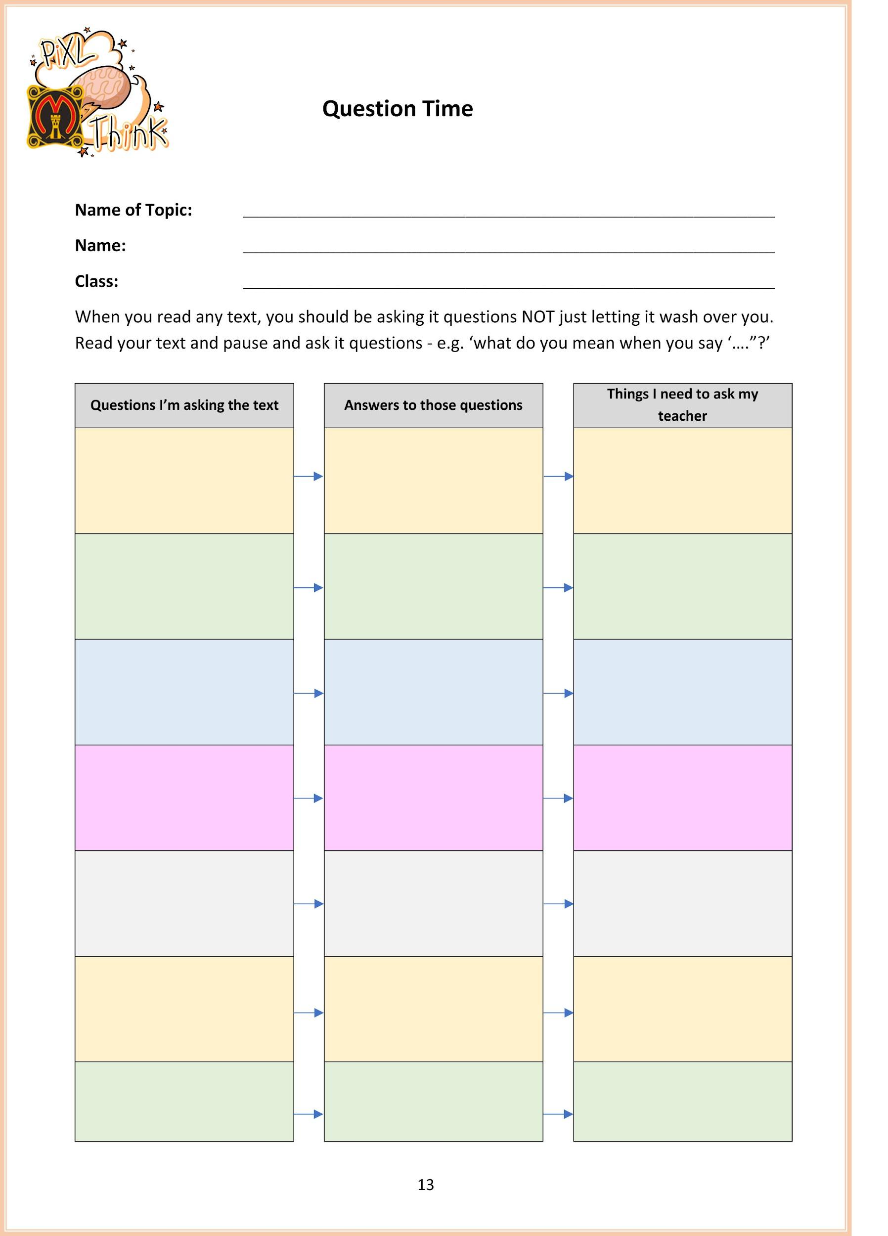

Slide 43


